Slide 1
OEL Project

Slide 2
Open Education Licensing: a toolkit for Australian educators
Robin Wright
Manager, Licensing, Acquisitions & Copyright
Swinburne University of Technology
Project leader, Open Education Licensing
rwright@swin.edu.au
Ph: +61 3 9214 4669

Slide 3
Open Education and Copyright
© & licensing – identified as critical challenge for online education
Interaction with Aust Copyright Act?
OER – 5 Rs – retain, reuse, revise, remix, redistribute!
More than just MOOCs / online access
Ongoing debate about FD/FU in Aust
Online education needs Open Licences!

Slide 4
Paris OER declaration
UNESCO 2012 World OER Congress
Teaching, learning and research materials in any medium, digital or otherwise, that reside in the public domain or have been released under an open licence that permits no-cost access, use, adaptation and redistribution by others with no or limited restrictions

Slide 5
Ljubljana OER Action Plan
UNESCO 2017 2nd World OER Congress
Open licensing is built within the framework of intellectual property rights as defined by relevant international conventions to respect the authorship of work. OER are a strategic opportunity to improve knowledge sharing, capacity building and universal access to quality learning and teaching resources.

Slide 6
Open Education Licensing project
Joint Swinburne / University of Tasmania
Research & development project 2015 - 17
Funding from Australian Government Office for Learning and Teaching
Examining OEP in Australian unis
Developing practical info / licensing tools

Slide 7
OEL project activities
2015 – Surveyed 389 staff from 38 Aust universities – 34% responded
Asked managers / teachers / info experts
Role of OEP in their institution
Current / planned ‘open’ activities
Platforms / licences used
Policy/strategic reasons
IP issues
2016 – Developed OEL Toolkit

Slide 8
Research outcomes/ about the sample

Slide 11
Platforms used by Australian universities to deliver open educational services

Slide 12
Why are Australian Universities participating in open education?
Reasons OER/OEP considered ‘very important’
59% - enhancing global profile of institution
54% - attracting more/new students
53% - innovating design of learning resources
52% - exploring new pedagogical practices
50.5% - marketing opportunities
Least important – commercial partnerships / competition
♫

Slide 13
Intellectual Property concerns
Primary IP concerns
88% - complexity of copyright and licensing (generally)
83% - copyright ownership of material on the internet
75.5% - understanding of open licences
71% - risk of infringing someone else's copyright’
♫

Slide 14
Who do staff think owns © in teaching materials?
48% think their institution is the primary owner of copyright in their teaching materials - with some rights granted to them
30% believe their institution is the sole copyright owner - with no rights granted to them

Slide 15
Overall findings
‘Open’ online content doesn’t always allow re-use
Over 50% see OER/OEP as important (& increasing)
High volume of open video on public platforms
Policies still being developed
Lack of knowledge / concern about complexity of open licensing
If copyright too difficult – OER not developed or disseminated
♫

Slide 16
Development of OEL Toolkit
Decision tree interface
Structured around OER dev/prod cycle
Provides personalised guidance & information – not legal advice
Links to relevant external info
Based on Australian law / institutions
Developed via stakeholder workshops

Slide 17
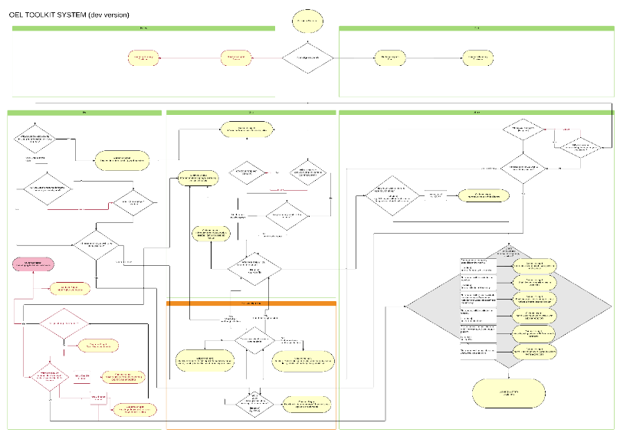
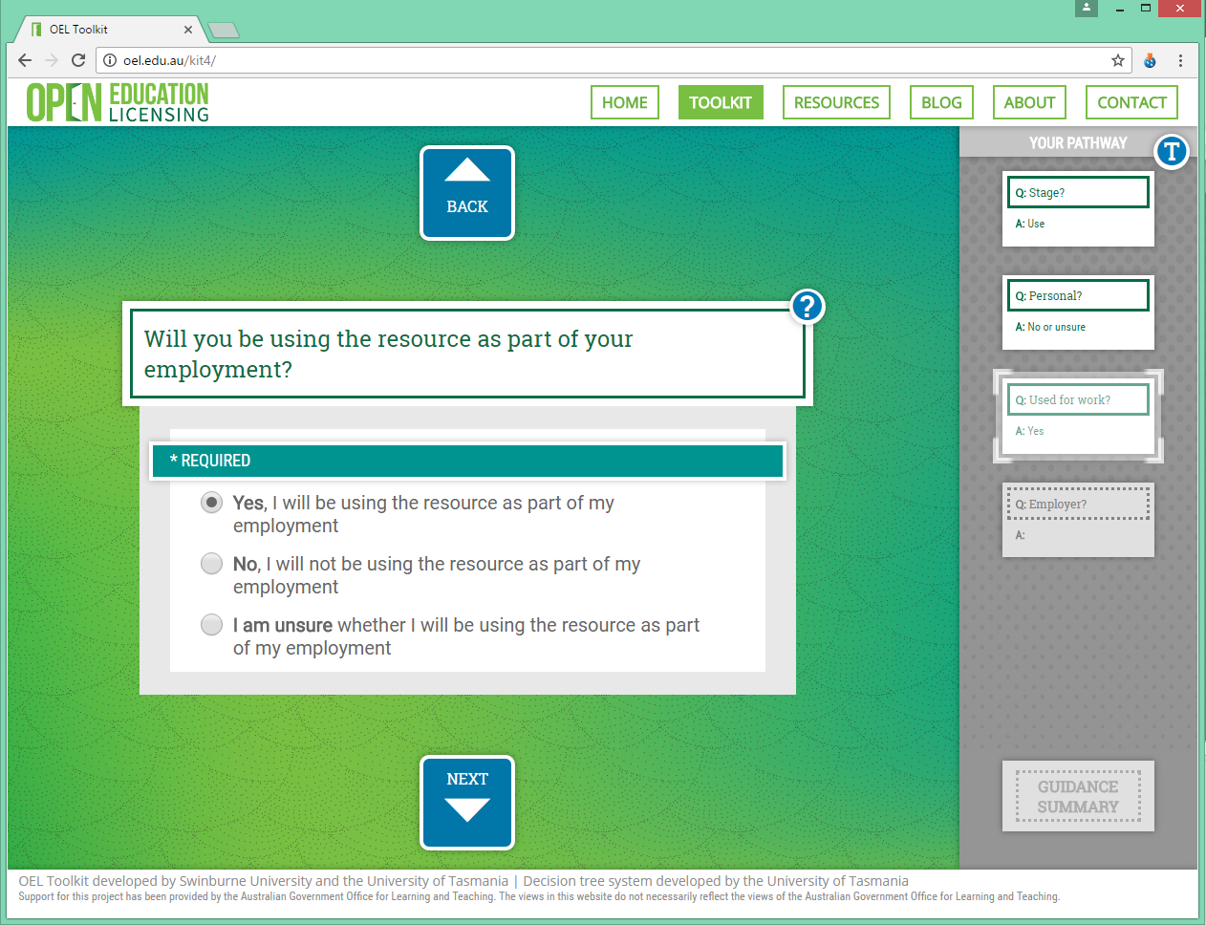
Design and development

Slide 19
Interactive demonstration

Slide 20
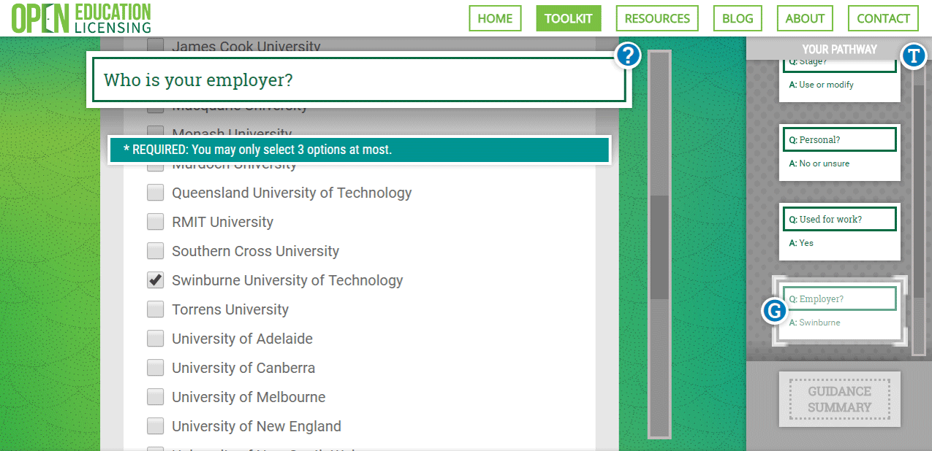
OEL Toolkit – improving understanding

Slide 21
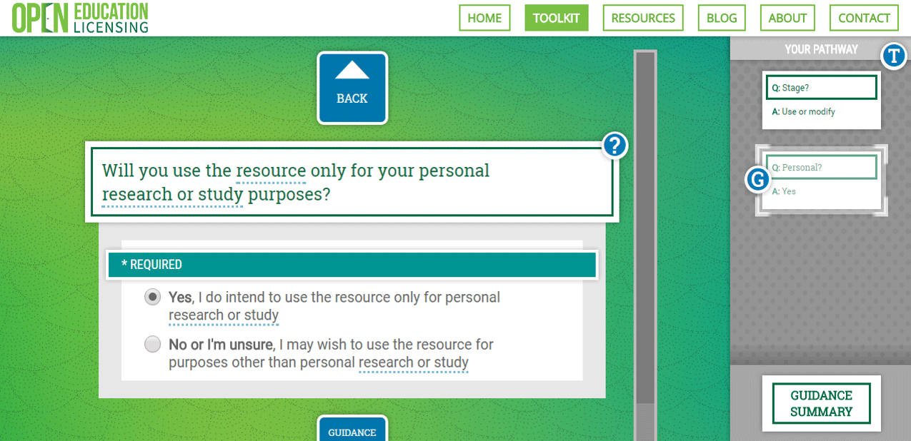
Existing exceptions – FD R&S

Slide 22
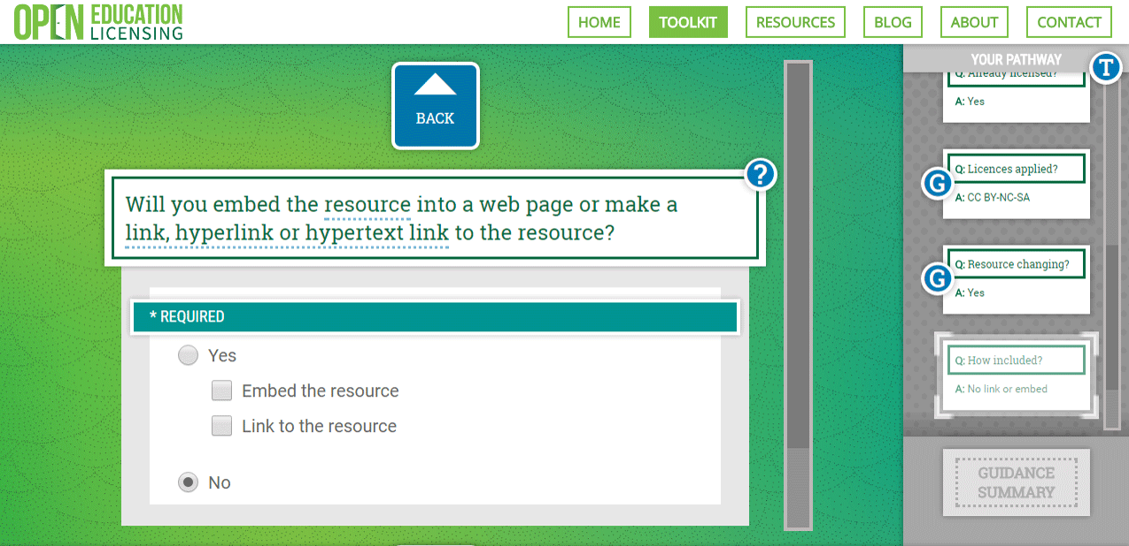
Linking or copying

Slide 23
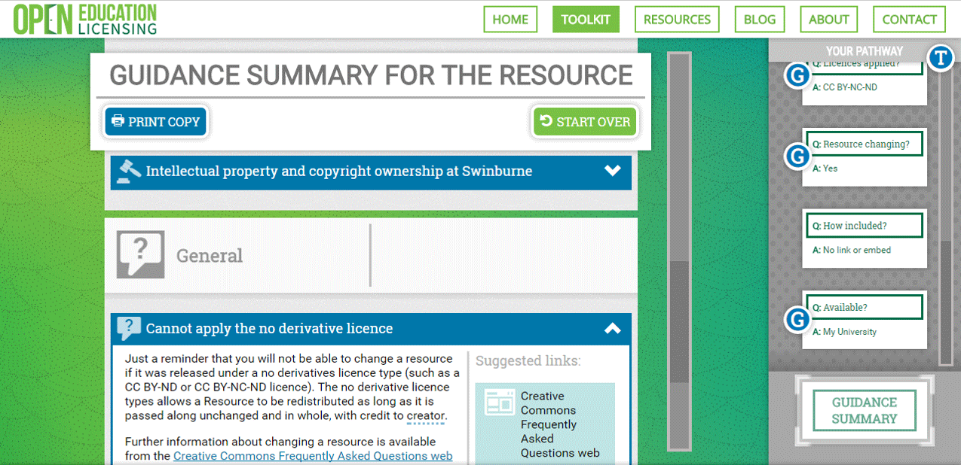
Licence interaction

Slide 25
Questions
Robin Wright
Manager, Licensing, Acquisitions & Copyright
Swinburne University of Technology
rwright@swin.edu.au
Ph: 03 9214 4669

Slide 26
Support for this project has been provided by the Australia Government Office for Learning and Teaching. The views in this presentation do not necessarily reflect the views of the Australian Government Office for Learning and Teaching.

