Slide 1
Break and Enter: Research participation doesn’t happen overnight
Maureen O’Brien
Senior Librarian (Health Sciences) ACU Strathfield
Maureen.Obrien@acu.edu.au
@MaureenTObrien

Slide 2
Session Objectives
Share ideas to learn strategies of ways we can build relationship, trust and rapport between library and faculty
Brainstorm strategies in creating opportunities for collaboration between library and faculty
Discuss ideas for becoming partners with faculty in research projects
Exploring ways in which librarians can transition from being a ‘support’ staff to embedded within faculty

Slide 3
Introductions – 10 mins
Name/place of work and role
Name one thing you are passionate about
What interested you about this session?
Have you participated in a research project?

Slide 4
The Research Project
To determine best practice in authentic assessment of pre-placement skills in MSW/BSW course programs

Slide 5
My role responsibilities
Working with team on Grant application
Sourcing relevant literature to support grant proposal
Co-writing ethics application, data management plan, project description
Developing and executing search strategies in selected databases
Managing/sharing EN library for scoping review
Reviewing reference list on final scoping review for publication acceptance
Facilitating data storage solutions

Slide 6
Deborah Boswell: The project
https://youtu.be/H3_G6kFVZ9Y

Slide 7
Breaking in
Building relationship and professional trust doesn’t happen overnight
We have our own approaches because we are all different

Slide 8
Discussion: Groups of 5 (7 mins)
http://bit.ly/2zofo3i

Slide 9
Dr Gabrielle Drake: Building relationship
https://youtu.be/rxfvz8foYVE

Slide 10
Difficulties: Breaking into academic space
Action based scenarios – 10 mins
Scenario 1: Physical Barriers
Scenario 2: Changing perceptions
Scenario 3: Resistance from gatekeepers
Scenario 4: You aren’t the same as the last librarian
(Pen and paper has been supplied for responses)

Slide 11
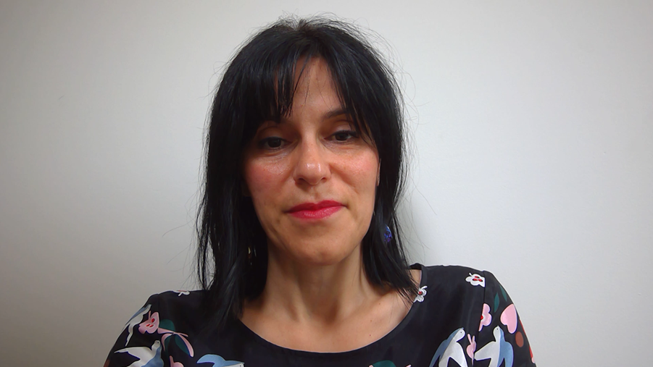
Sera Harris: Perceptions
https://youtu.be/1SokDMCkLoU

Slide 12
Discussion: Groups of 5 (10 mins)
http://bit.ly/2yovREz

Slide 13
Sera Harris: Project barriers
https://youtu.be/T5rHuqb2Q58

Slide 14
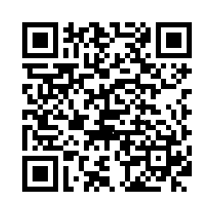
Feedback and thanks
I value your feedback. Please take the time to complete a short online survey:
http://bit.ly/2h4vDLA

Slide 15
Thanks for your time! I hope you found this session useful ☺ ☺ ☺

