Slide 1
Doing a PhD
Why on Earth would you do that to yourself?!
Dr Jane Garner - RMIT University
Romany Manuell - Charles Sturt University

Slide 2
Session Outline
Summary of our own PhD research
Exploring the experience of PhD study
Requirements, stages & outcomes of PhD study
Areas of research that suit doctoral study
Recent completions within the Australian GLAMR sector
Activity: Developing research questions

Slide 3
Ask Questions via GoSoapbox
Open URL: gosoapbox.rmit.edu.au
Event code: 902-187-400
Ask any questions, or propose topics that you would like us to talk about

Slide 4
Jane’s research
Garner, J (2017) Experiencing the use of Australian prison libraries: a phenomenological study. PhD thesis, RMIT University
SUPERvisors: Dr Sue Reynolds & Adjunct Professor Ross Harvey

Slide 5
My Research Question
How do Australian prisoners experience the use of a prison library?
Port Phillip Prison Library, Victoria

Slide 6
Research Method & Methodology
Visits to seven prisons:
Victoria
South Australia
Australian Capital Territory
Semi-structured interviews:
Twenty-nine prisoners
Seven prison staff
Phenomenology – Carl Moustakas
Alexander Maconochie Centre Library, ACT

Slide 7
Findings – Five Themes
Experiencing escape
Experiencing the passage of time
Experiencing community
Experiencing responsibility for self
Experiencing education
Port August Prison Library, South Australia

Slide 8
End Result

Slide 9
Romany’s research
Australian academic librarians as teachers
Australian academic librarians as educators
Australian academic librarians' perceptions of their role in education and training
The education and training role of Australian academic librarians (TBC!)
Supervisors: Dr Mary Carroll, Dr Mary Anne Kennan, Dr Barbara Combes

Slide 10
My Motivation
“Many of us became librarians precisely because we wanted to avoid getting up in front of groups. Unfortunately for those of us who thought we’d figured out the system and beaten it, the reality in today’s library is that you’re probably going to be presenting daily, or at least weekly, to some group or other. It may be staff training, or a tour, or a computer demonstration, but it will be instructional in nature and it will typically be for more than one or two people at a time. Surprise! Bummer!” (LaGuardia & Oka, 2000, p. 3).
Bill Branson, A librarian at the National Library of Medicine (NLM) is using an IBM computer to access PDQ, retrieved from: https://commons.wikimedia.org/wiki/File:Librarian_accessing_pdq.jpg
Still from Ferris Bueller’s Day Off, https://www.youtube.com/watch?v=uhiCFdWeQfA

Slide 11
My research question(s)
What are the variety of ways in which Australian academic librarians perceive their role in education and training?
What contribution does a curriculum background (experiences of education and training, including qualifications and/or practice) make to librarians’ perceptions of their role in education and training?
How do Australian academic librarians define their educative role, and what terms do they use to describe these education and training duties?

Slide 12
Research Methodology & Method
Interpretivist paradigm
Phenomenography (not phenomenology)
People’s perspectives of a phenomenon
The phenomenon is: the education and training role of the librarian
“Outcome space”: a set of categories that represent qualitatively different ways of seeing the world
Method: Semi-structured interviews

Slide 13
Benefits for GLAMR
Change library school curriculum?
Change Professional development?
Change employment practices?
Librarians with better education and training practices?
Better learning outcomes for students?
All of the above

Slide 14
The experience of doing a PhD - Good
Contribute to the industry
Develop new skills
Meet new people
Work intensively on one topic
Sense of achievement
Part of a learning community
Intellectually stimulating

Slide 15
The experience of doing a PhD - Bad
Takes lots of time!
Can be lonely
Relentless

Slide 16
The experience of doing a PhD - Ugly
Stressful moments
Existential angst

Slide 17
What to consider before you do this...
Time commitment
Work-life balance
Passion for the topic
Which university?
Supervisors
Partner who plays a lot of video games?
… it’s a good thing!

Slide 19
Requirements, stages, outcomes at RMIT
Timing
PhD: 3 - 3.5 years full-time or 6 - 7 years part-time
Masters by research: 2 years full-time
Can take leave of absence
Can change time fraction
Cost
The Government’s Research Training Program (RTP) provides a Fee Offset Scholarship to Australian citizens and permanent residents and New Zealand citizens. This scholarship does not provide any form of payment to candidates. It simply funds the place in a research program for all Australian citizens and permanent residents and New Zealand citizens.

Slide 20
How to apply - RMIT University
• Check your eligibility
• Prepare a research proposal
• Find your supervisors
• Apply

Slide 21
PhD Entry Requirements - RMIT University
The minimum requirements for admission to a PhD program are:
a bachelor's degree requiring at least four years of full-time study in a relevant discipline awarded with honours. The degree should include a research component comprised of a thesis, other research projects or research methodology subjects that constitute at least 25% of a full time (or part time equivalent) academic year. The applicant must have achieved at least a distinction average in the final year; or
a master's degree that includes a research component comprised of at least 25% of a full time (or part time equivalent) academic year with an overall distinction average or a master's degree without a research component with at least a high distinction average; or
evidence of appropriate academic qualifications and/or experience that satisfies the Associate Deputy Vice-Chancellor, Research Training and Development or nominee that the applicant has developed knowledge of the field of study or cognate field and the potential for research sufficient to undertake the proposed program.
At RMIT a grade of Distinction represents academic achievement of 70% or higher and a High Distinction is 80% or higher.

Slide 22
Alternative entry - RMIT University
Enrol in a Research Masters Degree and upgrade to PhD at the end of year one
Entry to Master’s requirements:
a bachelor's degree requiring at least four years of full-time study in a relevant discipline awarded with honours. The degree should include a research component comprised of a thesis, other research projects or research methodology subjects that constitute at least 25% of a full time (or part time equivalent) academic year. The applicant must have achieved at least a credit average in the final year; or
evidence of appropriate academic qualifications and/or experience that satisfies the Associate Deputy Vice-Chancellor, Research Training and Development or nominee that the applicant has developed knowledge of the field of study or cognate field and the potential for research sufficient to undertake the proposed program.
At RMIT a grade of Credit represents academic achievement of 60% or higher.

Slide 23
RMIT - Milestones
3 Milestone reviews
1st (Confirmation)
2nd (Mid-candidature)
3rd (Completion)
Each requires submission of substantial written work
Presentation to a panel of academics each time
They ensure you are on track and that your research is of a sufficiently high standard

Slide 24
RMIT - Examination process
Completed thesis sent to examination
Two examiners (secret!)
Four result options

Slide 25
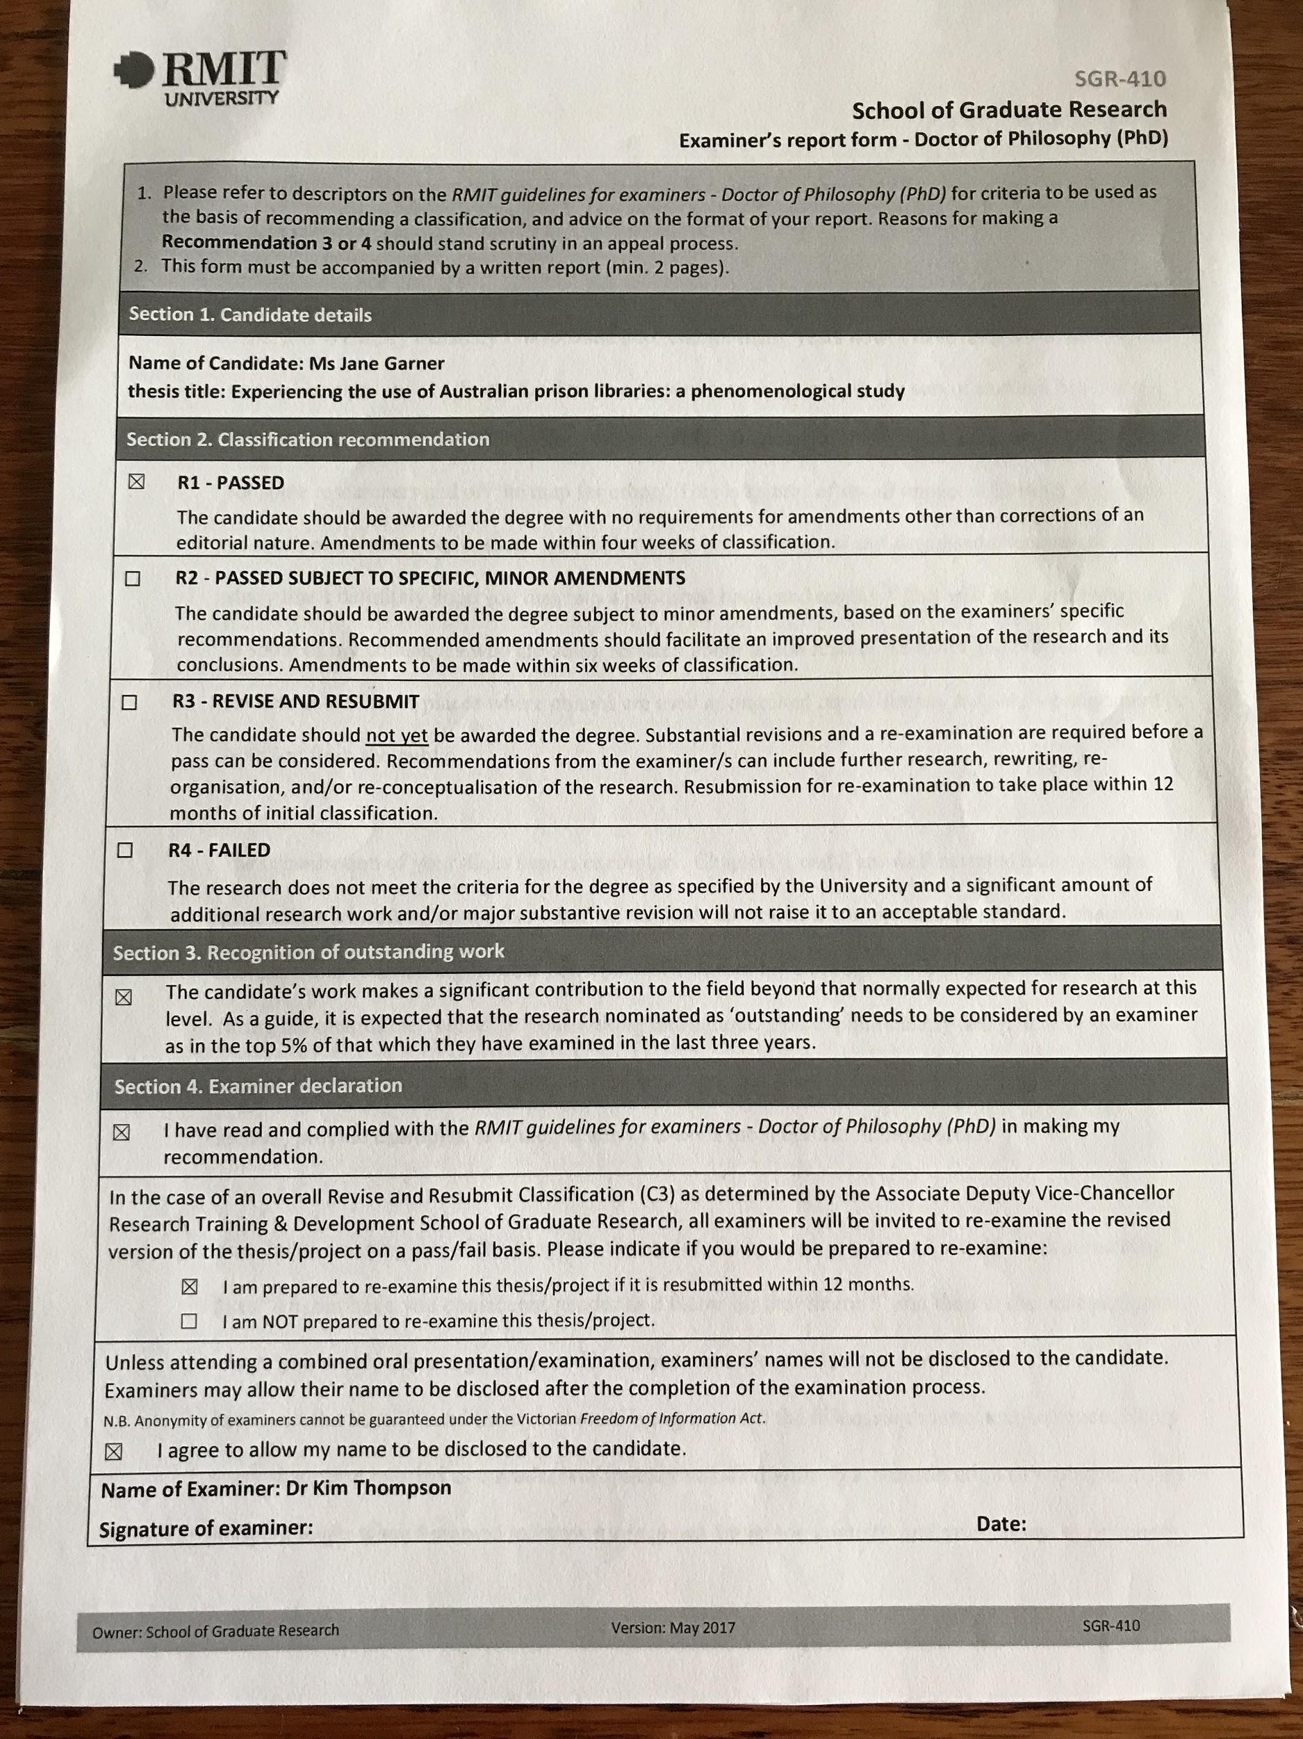
Results of examination options

Slide 26
CSU - Application
Identify your research passion
Review the requirements
Review the staff profiles page
Contact the School of Information Studies HDR Coordinator(s) for details
Prepare for interview with potential supervisors
Apply for formal admission

Slide 27
CSU - Timing and cost
Timing
What Jane said… 6 years minimum for part-time candidates
You arrange your supervisory schedule with your Supervisors
6 monthly check-ups via automated online system with alerts if any party thinks you’re not up to scratch
Research Retreat (School of Info Studies), Faculty Symposium,
Cost
What Jane said, PLUS! Operating funds! $600 per semester! :D

Slide 28
CSU - Requirements for endorsement of candidature
1. Participate in an online HDR induction workshop;
2. Complete any specified coursework subjects
3. Complete a draft literature review
4. Submit a research proposal - 20,000 words (including literature review)
5. Present a seminar based on proposed research - 20 minutes + Q&A
6. Complete any other additional requirements as specified during Admission, including but not limited to: completion of a meta-analysis of existing research, completion of a pilot study, development of a test battery, development of software, learning a programming language
7. Revise the proposal, if needed, following consideration of the confirmation panel’s feedback.

Slide 29
CSU - After endorsement of candidature
Ethics approval
Begin data collection
And continue…

Slide 30
Areas of research that suit Doctoral Studies
It has to be an original contribution to knowledge
Gap in the literature
An approach that nobody has used before
An approach that somebody HAS used before, but you might employ differently
A clear question, neither too broad or narrow
Perhaps something you can’t guess the answer to?

Slide 31
Recent GLAMR PhD Completions
Lyons, SJ (2015) Challenging placelessness: site specific art within the gallery. PhD thesis, Curtin University http://hdl.handle.net/20.500.11937/2172
McKernan, A (2016) Uncomfortable histories: learning with contested and confronting history in Australian museums. PhD thesis, University of Melbourne. http://hdl.handle.net/11343/124097
Saravani, S (2013) Delivering mobile library services : competency implications for vocational education and training library staff. PhD thesis, Curtin University http://hdl.handle.net/20.500.11937/903

Slide 32
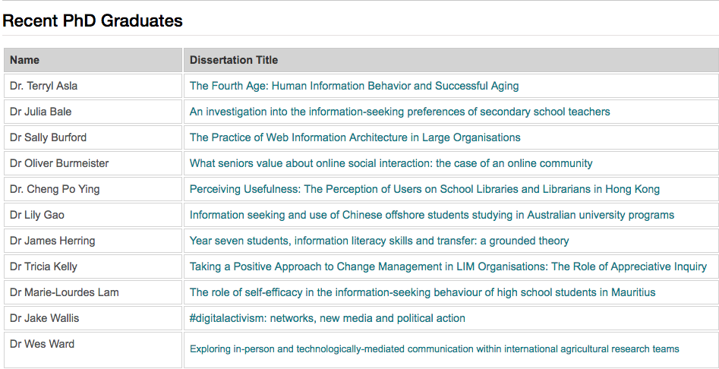
PhD Completions CSU 2008 - 2016

Slide 33
PhD Completions RMIT
Henczel, S 2016, The impact of national library associations on their members, employing organisations and the profession, Doctor of Philosophy (PhD), Business IT and Logistics, RMIT University.
Huynh, T 2016, Library leadership and succession planning in Vietnam, Doctor of Philosophy (PhD), Business IT and Logistics, RMIT University.
Adamopoulos, A 2014, Information behaviour of online investors, Doctor of Philosophy (PhD), Business IT and Logistics, RMIT University.
Vo-Tran, H 2014, Information management and sharing practices within a construction project process, Doctor of Philosophy (PhD), Business IT and Logistics, RMIT University.
Mohamed Shuhidan, S 2013, Information-seeking processes among primary school children in Australia and Malaysia, Doctor of Philosophy (PhD), Business Information Technology & Logistics, RMIT University.

Slide 34
Activity
Get into groups of 3 people
Discuss your ideas for a PhD or research project topic.
As a group, try to write a topic as a single research question
Report back to whole session

Slide 35
Any questions??

Slide 36
More information
RMIT University
Admissions and Scholarships Team School of Graduate Research
Email : sgr.admissions@rmit.edu.au Phone: 613 9925 5570
Research Programs: https://www.rmit.edu.au/study-with-us/levels-of-study/research-programs
Dr Sue Reynolds: sue.reynolds@rmit.edu.au 9925 1310
Charles Sturt University
School of Information Studies HDR Coordinators:
Dr Mary Anne Kennan
Dr Kim Thompson
http://arts-ed.csu.edu.au/schools/sis/research/phd

