Slide 1
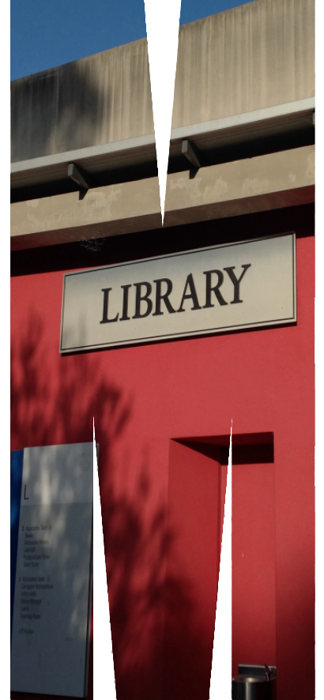
YouTube Annotations: making videos interactive
Kim Ferriere and Allie Ford

Slide 2
Overview
Snapshots of Healthcare project
Adding annotations demo
Hands-on time!
Top tips
Image credit: Peggy_Marco CC0 via pixabay.com

Slide 3
Snapshots of Healthcare
Second year OT EBP unit needed help!
$$$ Grants from School of Primary Healthcare and BLBT
Video interview repository
Interviews are interesting…
... But looooooong!
Need a way to navigate
Example: http://snapshotsofhealth-project.blogspot.com.au/
Image credit: Peggy_Marco CC0 via pixabay.com

Slide 4
Live demo!
Image credit: Peggy_Marco CC0 via pixabay.com

Slide 5
Your turn!
Image credit: Peggy_Marco CC0 via pixabay.com

Slide 6
Top tips
Can use annotations on any YouTube video
Think ahead during creation and editing
Plan times for menus or links
Can’t copy annotations!
Check video carefully before annotating!
Right account
No audio/video errors
Menu screens are long enough
Nothing is missing
Annotations take time
Avoid too many options (if possible)
Image credit: Peggy_Marco CC0 via pixabay.com

Slide 7
Any questions?
Image credit: Peggy_Marco CC0 via pixabay.com

