Slide 1
‘Every day I wear many hats’
How the library can help them fit more easily!
Brad Aisbett, PhD Associate Head of School (Teaching and Learning)
School of Exercise and Nutrition Sciences

Slide 2
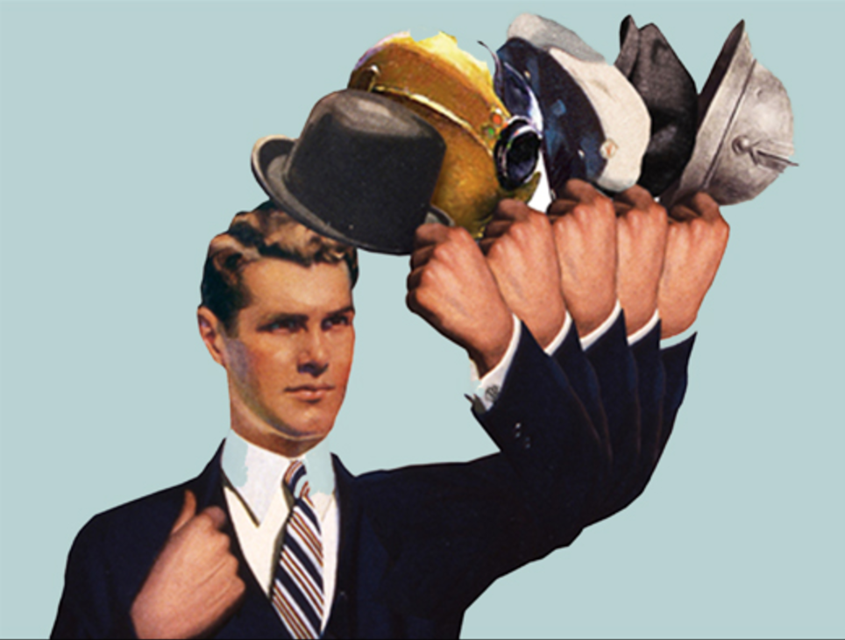

Slide 3
My hats…
Unit Chair
Practicum Co-Ordinator (2008 – 2013)
HDR & Honours Research Supervisor
HDR Coordinator (2013 - 2015)
Research Leader
Associate Head of School (2016 - )

Slide 5
Unit CHair
“Deakin will be Australia’s premier university in driving the digital frontier to …offer a brilliant education where you are and where you want to go…”
Premium cloud and located learning experience
Flipped classroom
Learning materials pre-supplied via LMS
On-campus:
Individual assessment of understanding
Team-based application of knowledge – writing training programs under time pressure

Slide 6
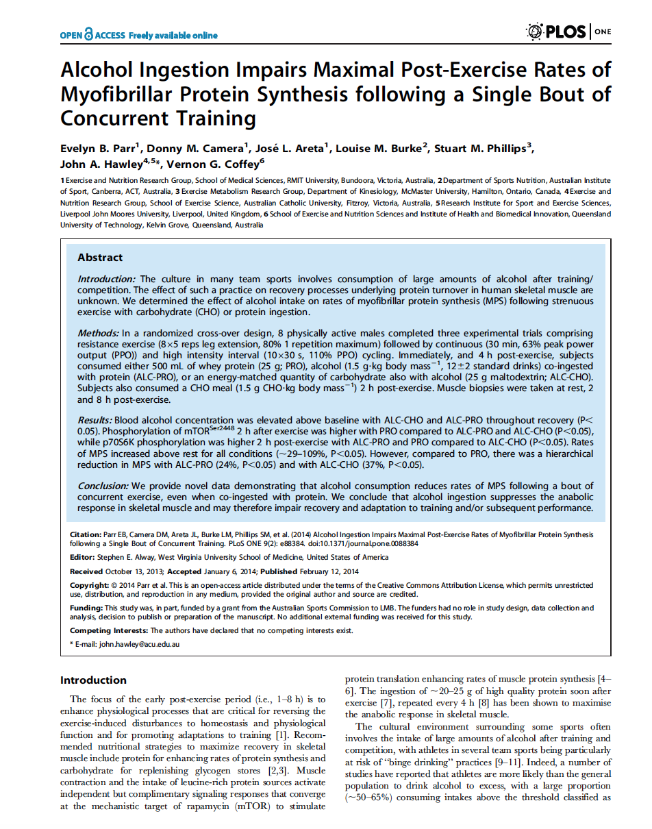
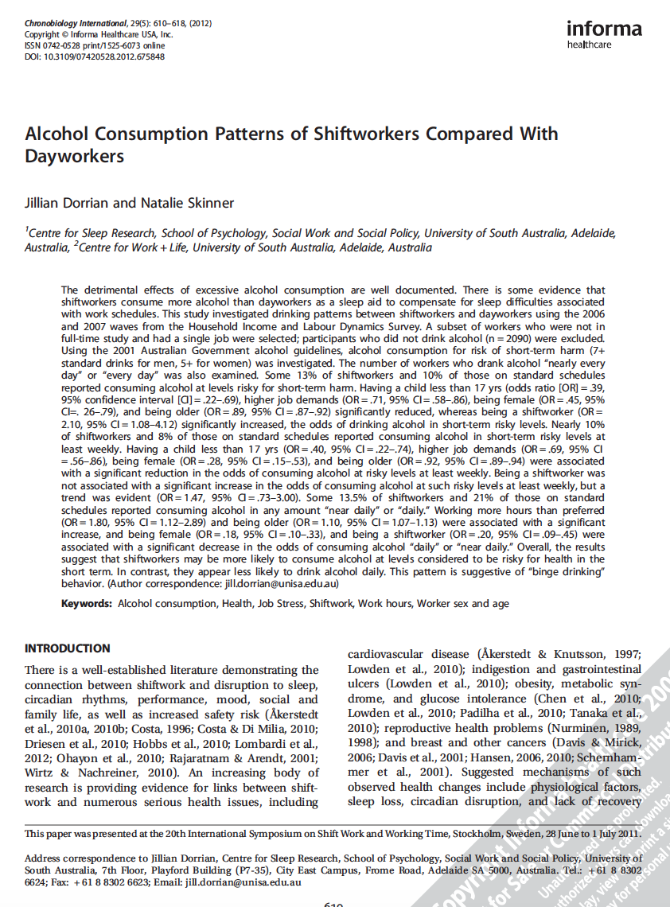
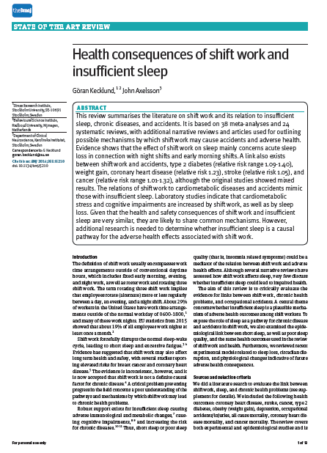
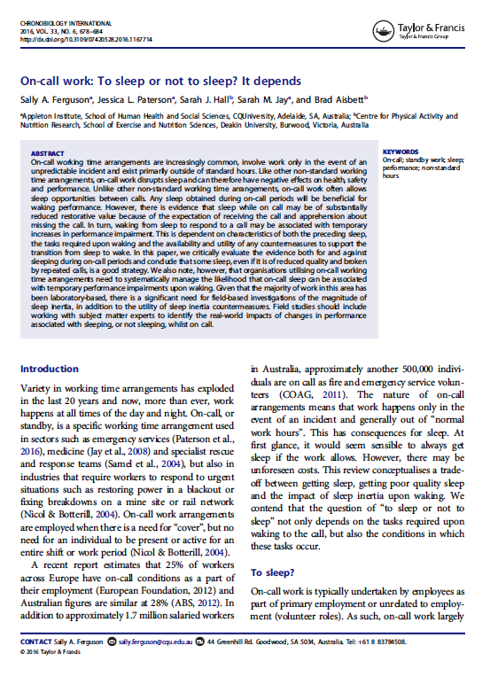
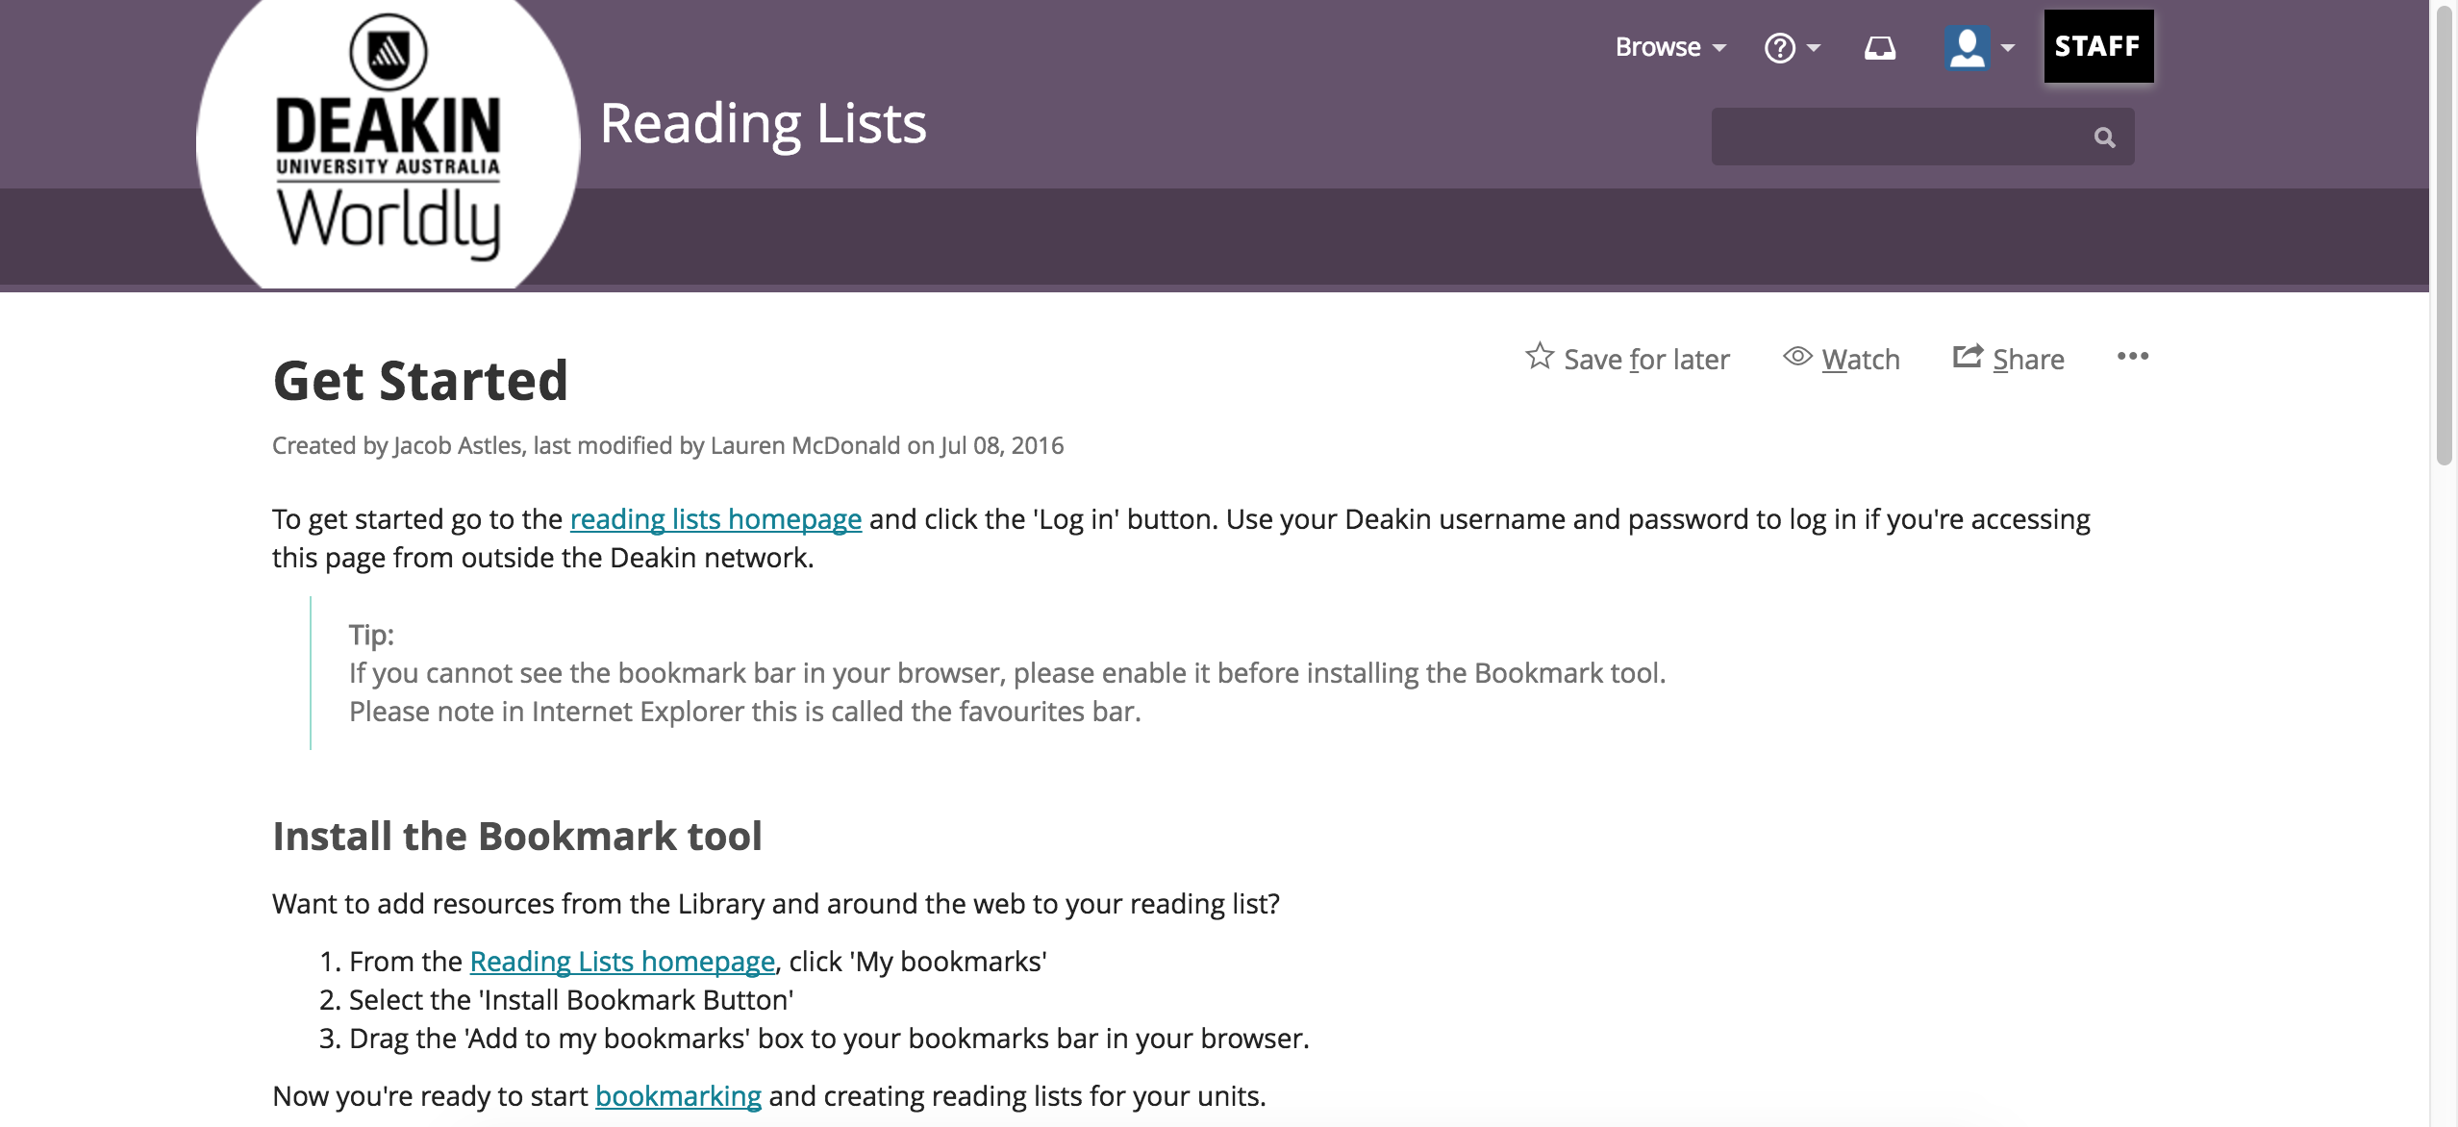

Slide 7
HDR Supervisor
“Deakin will…make a difference through world-class innovation and research that makes a difference to the communities we serve.”
Grow research capacity, depth and breadth
Foster student autonomy
School & industry engagement
Research dissemination
Strategic decision making re: publication targets, conference attendance and non-PhD work

Slide 8
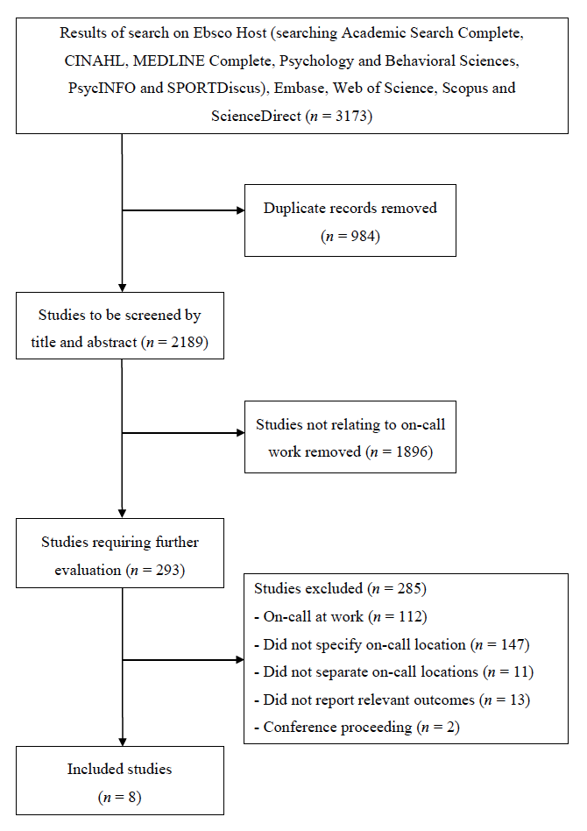

Slide 9
HDR Supervisor
“Deakin will…empower learners for the jobs and skills of the future and make a difference through world class research”
Publishing
≥ 3 publications @ graduation
Improved examination results
Internal awards during candidature
Job competition
Fellowship applications
Teaching and Research positions

Slide 10
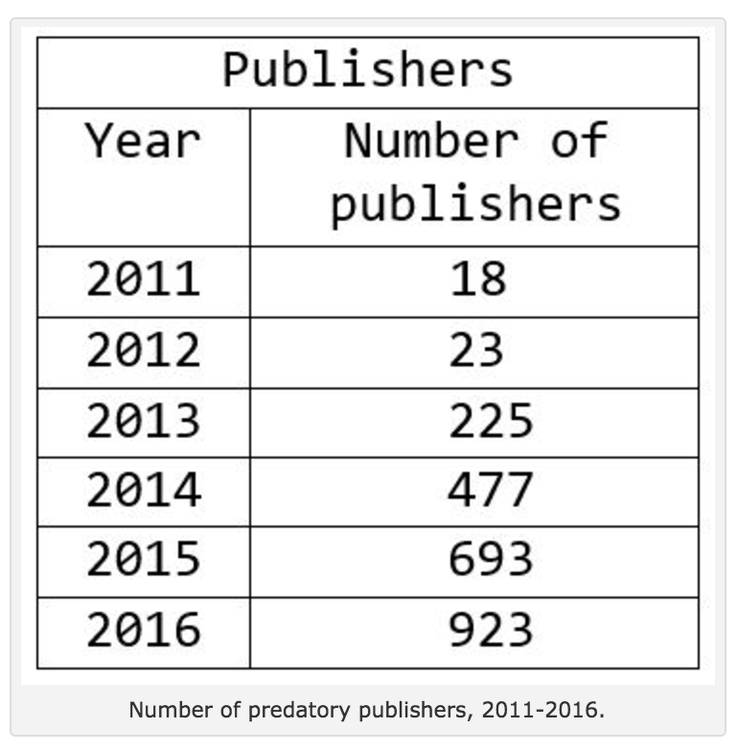
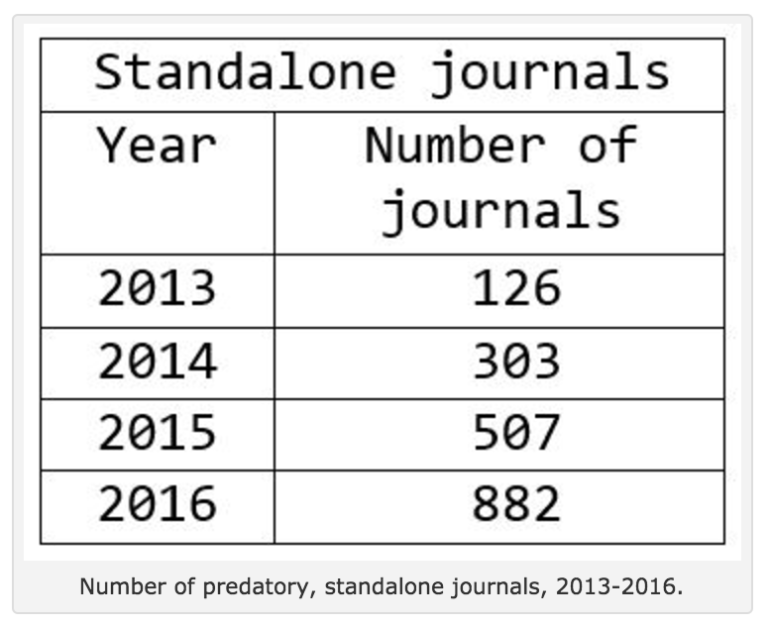

Slide 11
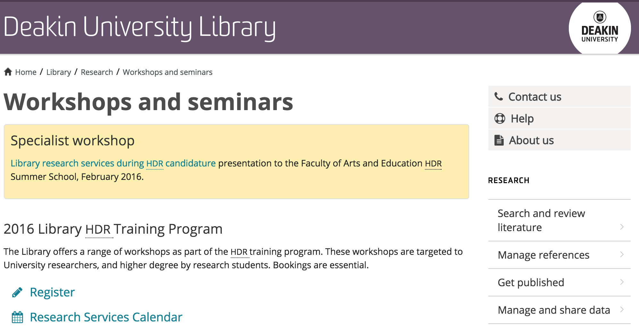
HDR SUPERVISOR

Slide 12
HDR COORDINATOR
“Deakin will… grow research capacity, depth and breadth and build employee capacity, capability and productivity”
Quality Assurance for students and supervisors
Selection of candidates & scholarship holders
Confirmation of PhD enrolment
Support for students and supervisors
Ranking candidates for awards
Overseeing thesis submission

Slide 13
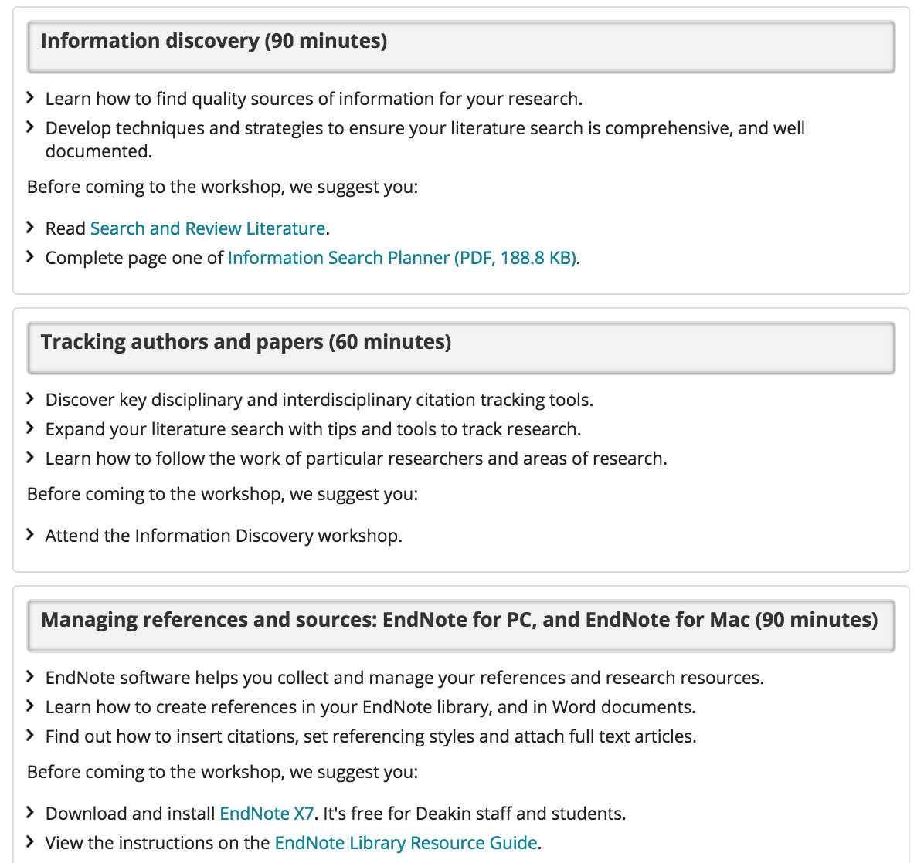
HDR COORDINATOR

Slide 14
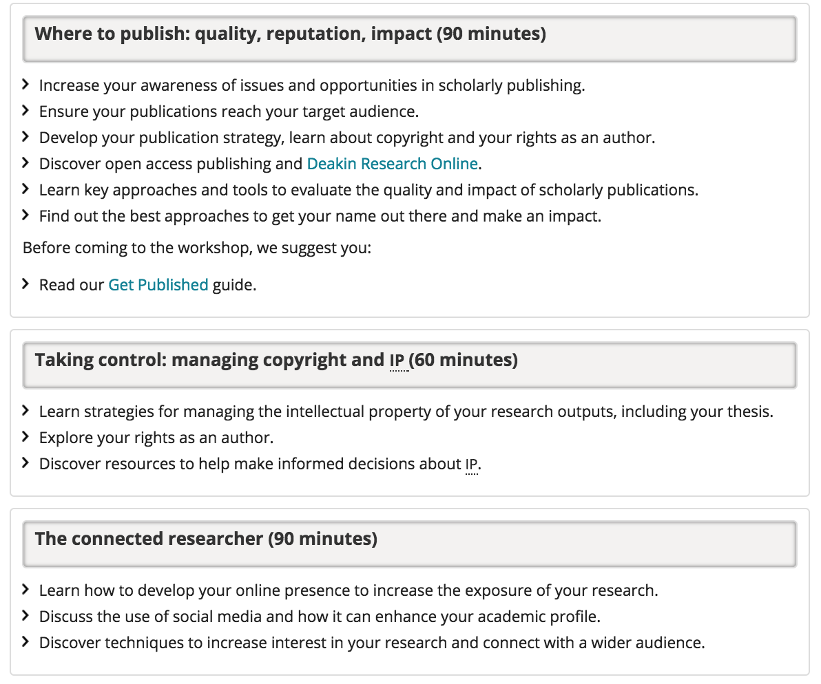
HDR COORDINATOR

Slide 15
RESEARCH LEADER
“Deakin will… research that makes a difference to the communities we serve and develop a strategic international research footprint and add value to governments, industry, alumni and the communities that Deakin serves”
Impact
Visibility
Interdisciplinary

Slide 17
visibility
ORCID
Research Gate
Academia
Loop
Google Scholar
Elements
Deakin Research Online

Slide 18
Interdisciplinarity
According to Web of Science…
232 Journal categories
8 ‘Multi-disciplinary’ categories
2 ‘Inter-disciplinary’ categories
0 ‘Trans-disciplinary’ categories

Slide 19
So I guess that means…
Grants
HDR students
Publications
Trans-disciplinary
Inter-disciplinary
Multi- disciplinary

Slide 20
Associate head of school
Oversee Bachelor of Exercise and Sport Science (BEx&SpS) academic programs;
Manage allocation of BEx&SpS teaching staff workloads;
Advise and represent Head of School as appropriate

Slide 21
Associate head of school
Embedded liaison librarian inside school on a weekly bases for students and staff;
In-house workshops tailored to different research groups;
Tailored internal forms to include engagement with library services before approval.

Slide 22
Practical strategies
‘Active learning’ workshops
Institutes, course teams, student inductions
Timely prompts to HDR Coordinators, Unit Chairs, Course Directors, A-HoS:
February
April
August
October

Slide 23
Messaging
Speak to academic values
Speak to academic KPIs
Citations, Income, Efficiency, Impact
Secure and invest in local champions
Remember, emotion will trump rationality

Slide 24
Thank you

Slide 25
…a little about me…
PhD: 2006
Deakin: 2008 - present
Publications: 67 (58 C1, 9 E1)
Cat I – IV research funding: $1.8 million
Students: 6 PhD conferred, 2 current, 14 honours
Teaching: Practicum Coordinator 2008 – 2013
Physical Training Unit Chair 2008 – 2016
Service: HDR Coordinator 2012-2016

