Slide 1
Seeding the Commons / ANDS dataset collection process
Presented at CRIG Forum 1st June 2012 by Barry Tucker, Deakin University
Deakin University CRICOS code: 00113B

Slide 2
To collect information and contribute descriptions of at least 50 research datasets produced by Deakin University researchers to the Australian Research Data Commons

Slide 3
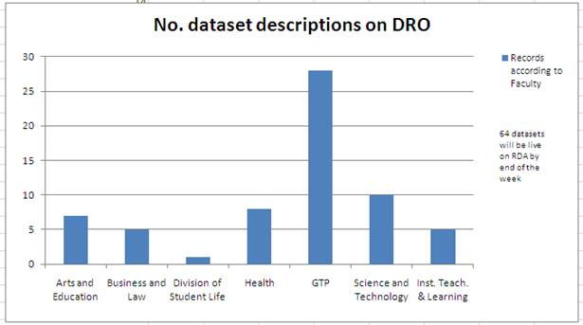
From where are the dataset descriptions obtained?

Slide 4
The research data interview process
Selecting researchers
Use of librarians’ knowledge, research newsletters, news media, university web sites, and research admin officers to target key players
Serendipity (being out there)- door knocking in research areas, meeting researchers in hallways and even in car parks!
Researchers’ attitudes vary and are usually time poor

Slide 5
The research data interview process
Spread sheet used to track research contacts and current status of the interview cycle
Interview process was streamlined
The interview questionnaire template was replaced by the proforma- i.e.47 questions reduced to 34- process now a consultative selling “facilitating” relationship
Use of exemplar proformas to facilitate in
self submission

Slide 6
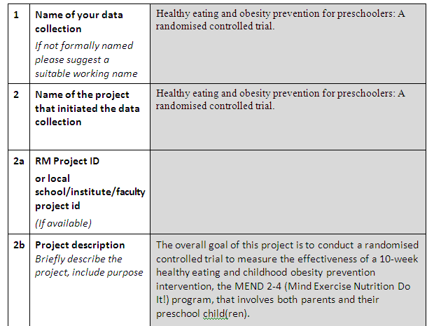
Proforma

Slide 7
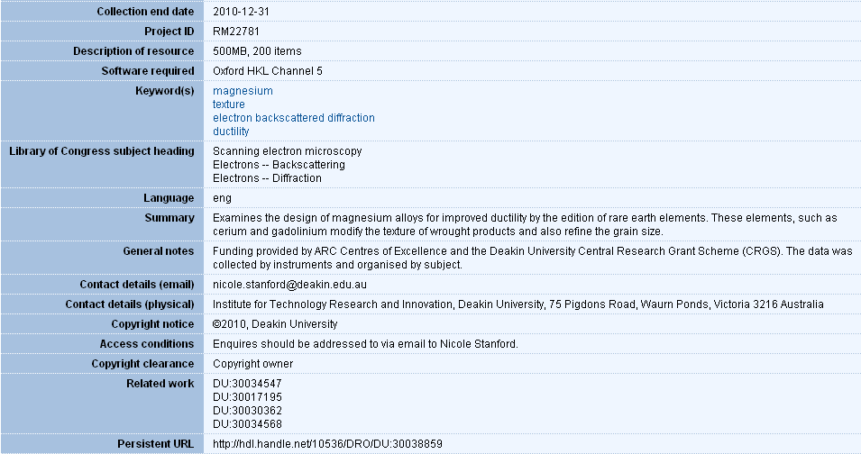
DRO record

Slide 8
Persistence & Determination
"Nothing in the world can replace persistence. Talent will not; Nothing more common than the unsuccessful man with talent. Genius will not; unrewarded genius is almost a proverb. Education will not; the world is full of educated derelicts. Persistence and Determination are omnipotent.".
-- Calvin Coolidge U.S. President (1923 – 1929)

Slide 9
Thank you
Barry Tucker
barry.tucker@deakin.edu.au

