Slide 1




A match made in heaven:
Practitioners and academics researching together
Sue Reynolds, Senior Lecturer, RMIT University
Ellen O’Hehir, Librarian, Monash University
CRIG Seminar
November 8, 2017

Slide 2
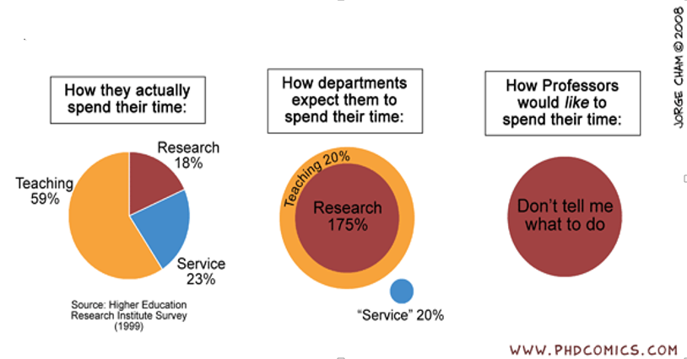
How professors spend their time…

Slide 3
What we do…
Good Teaching Score (GTS) and Overall Satisfaction Index (OSI)
Teaching
Needs/expectations of students
Needs/expectations of industry and the professional bodies
Publications
Research income
Higher Degree by Research (HDR) (Masters by Research and PhD) timely completions
Research
To the university
To the profession
To the community
Service

Slide 4



Alls ralian Library and |  | ·-­
Information Assocration | HOME | MAIN MENU
Q
SEARCH CONTACT
Open access resources > Policies, standa rds and guidelines >
NEW
The Library and Information S,ector: Core Knowledge, Skills and Attributes
EVH
•
Adopted 1998. Amen ded 2009. Reviewed 2012 . Amended 9 December 2014 A pd f version of this policy can be found - - :
Preamble
The Library and information sector has a distinctive area of kn owledge and ski lls which is req u i red for effect ive professional
practice. Library and i nformat ion specialists need to acq u i re the relevant di sci pli na ry expertise. demonstrate employment related skills and be prepared for a cha llengi ng and dyn am ic future in many d iverse envi ronments.
Core Knowledge Statement
The Library and informati on specia list must ensu re a h i g h standard of library a nd i nformation practice th rough education and
trai n ing, whi le conti nuing to evolve and develop with the overall fra mewor k of core kn owledge, skills, attr i butes and
Reference: https://www.alia.org.au/about-alia/policies-standards-and-guidelines/library-and-information-sector-core-knowledge-skills-and-attributes

Slide 5
Generation of knowledge
Library and information specialists must be able to:
expand knowledge according to the state of research and practice in information behaviour
continue lifelong learning through a professional development scheme
systematically gather and analyse data and disseminate the findings to advance library and information science theory and its application to the provision of information services
demonstrate a commitment to the improvement of professional practice through a
culture of research, evidence-based information practice and knowledge retention
demonstrate effective and appropriate research skills
Reference: https://www.alia.org.au/about-alia/policies-standards-and-guidelines/library-and-information-sector-core-knowledge-skills- and-attributes

Slide 6






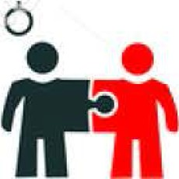



6
6
6
-·-'
6
t®
INSPIRATION SUCCESS
l
aVlOifiVATIO N
•
SUPPORT
TEAMWORK
COMMUNICATION
TRUST

Slide 7
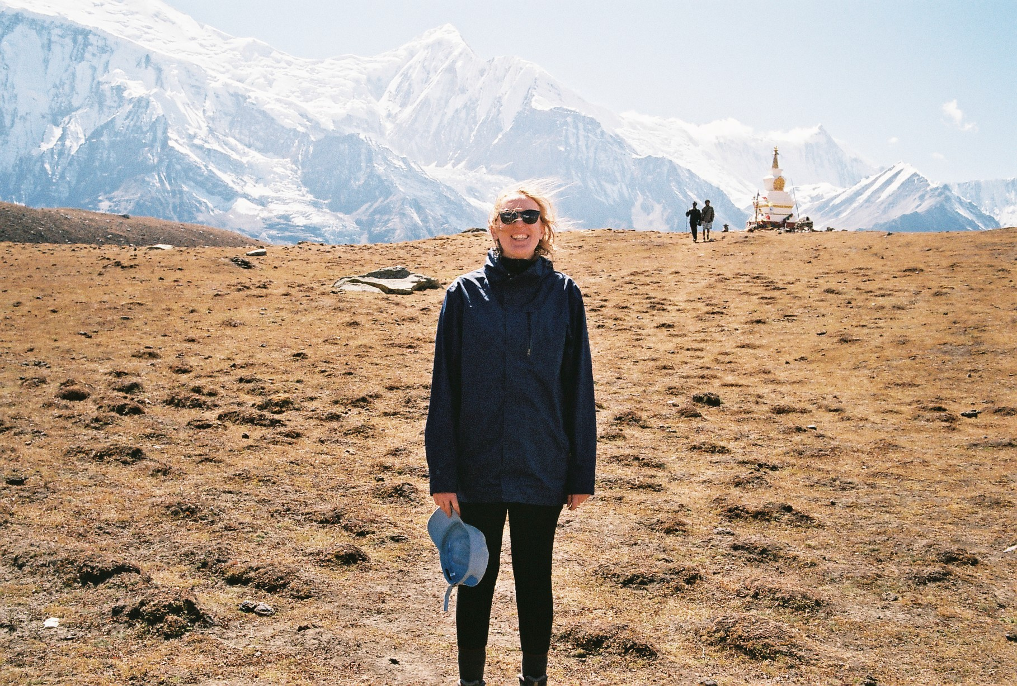
Meet Ellen

Slide 8


Student Me
100%
Research

Slide 9








Early Career Librarian Me
During semester
4%
0%
6%
20%
5%
5%
30%
10%
20%

Slide 10






Early Career Librarian Me
Outside of semester
Developing e-learning resources
Working with Subject Librarians on
developing & updating teaching material, library guides, collection development Meetings and committees
5%
3%
30%
Project work
40%
Professional development (Attending seminars and workshops, training)
15%
Research
7%

Slide 11







Breakdown of Subject Librarian role
Special Collection Subject Librarian
1%
3%
5%
1%
Selecting & ordering Enquiries & consultations Reporting & stats Donations
Ada Booth Fellowship Community outreach Planning
Research
5%
5%
ALIA Students & New Graduates Group National Convenor :
10 hours per week
5%
75%

Slide 12





Breakdown of Subject Librarian role cont.
Art, Design and Architecture Librarian
Inquiries & consultations (UG, PG, Staff, colleagues)
Reporting and stats
30%
40%
Research for PhD completed outside work time:
20 hours per week
Donations
Committees
Teaching
20%
5%
5%

Slide 13
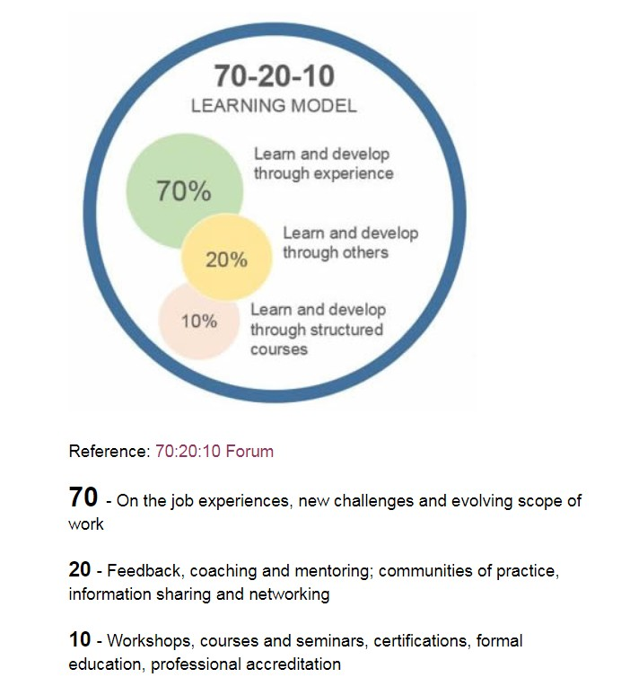
On the job learning, learn from colleagues
70%
Supervisor, more experienced colleagues, being involved in the Cross Institutional Mentoring Program
20%
10%
Attending workshops, courses, seminars, training

Slide 14
Staff development plan
UniCRM training for ask.monash queries
Pedagogical approaches for embedding information skills into Units
Video creation & editing
Collection development
Cross Institutional Mentoring Program
Augmented reality
Visualisation of statistics
More advanced use of Moodle
Research for ALIA Online conference presentation
H5P for
e-learning project

Slide 15
Australian Research Council’s definition of research
Research is defined as the creation of new knowledge and/or the use of existing knowledge in a new and creative way so as to generate new concepts, methodologies, inventions and understandings. …
This definition of research is consistent with a broad notion of research and experimental development as comprising ‘creative work undertaken on a systematic basis in order to increase the stock of knowledge, including knowledge of man [human-kind], culture and society, and the use of this stock of knowledge to devise new applications’.
Reference: http://www.arc.gov.au/sites/default/files/filedepot/Public/ARC/Research%20Impact/Glossary_for_research_impact.pdf

Slide 16
Staff development plan
UniCRM training for ask.monash queries
Pedagogical approaches for embedding information skills into Units
Video creation & editing
Collection development
Cross Institutional Mentoring Program
Augmented reality
Visualisation of statistics
More advanced use of Moodle
Research for ALIA Online conference presentation
H5P for
e-learning project

Slide 17
Benefits of practitioner and academic collaboration
Academics
Research impact
Influencing the sector
Inform how to design courses to be relevant for the needs of the profession (eg. digital literacy required by young GLAMR prof)
Fostering industry links and understanding
Common
New projects that are concerned with current developments in academic libraries
Networking
Strengthening profession by increasing respect for research ability
Research Impact for academic and practitioner aligned with ERA’s focus on community engagement and real word impact. For LIS academics, libraries are the ‘real world’ industry.
Breaking down silos
Librarians
Get name out there – be known as an industry leader
Understand research practice e.g. methodology, peer review, current topics
Strengthen relationships with Faculty and individual researchers
Strengthen Library and University’s reputation
Part of life long learning

Slide 18
Generation of knowledge
Library and information specialists must be able to:
expand knowledge according to the state of research and practice in information behaviour
continue lifelong learning through a professional development scheme
systematically gather and analyse data and disseminate the findings to advance library and information science theory and its application to the provision of information services
demonstrate a commitment to the improvement of professional practice through a
culture of research, evidence-based information practice and knowledge retention
demonstrate effective and appropriate research skills
Reference: https://www.alia.org.au/about-alia/policies-standards-and-guidelines/library-and-information-sector-core-knowledge-skills- and-attributes

Slide 19

Image source: http://www.l andmarkprofessio nal.netljoin-our-team/ope n-job-posti ngs/help-wanted-ad- 2/

