Slide 1
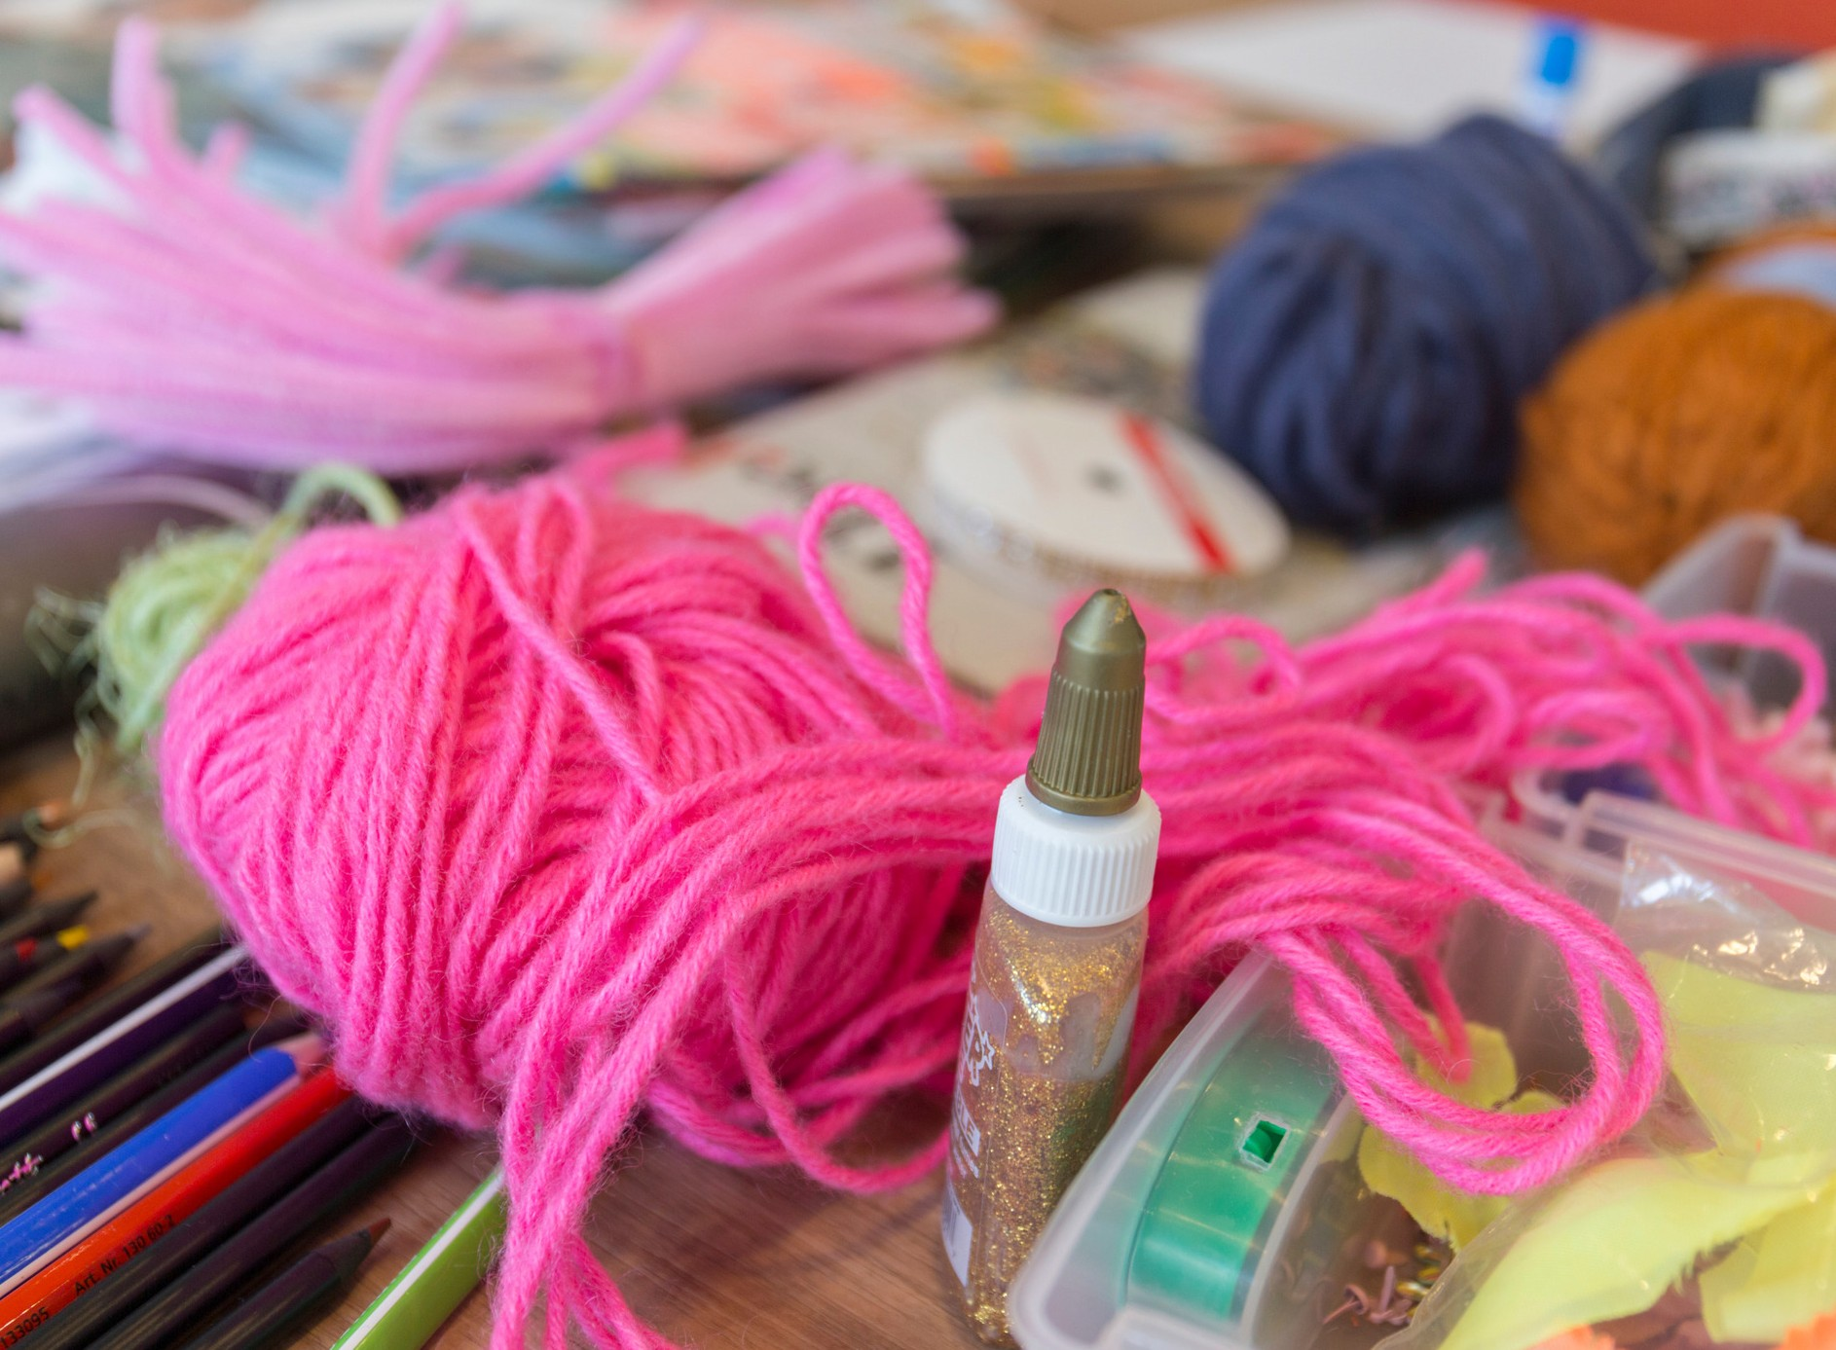

Gathering the glue and the glitter: a visual arts- based inquiry into academic perceptions of liaison librarians
C R I G S E M I N A R 2 0 1 7
Deirdrie Gregory Marina Minns Josephine Le Clerc

Slide 2
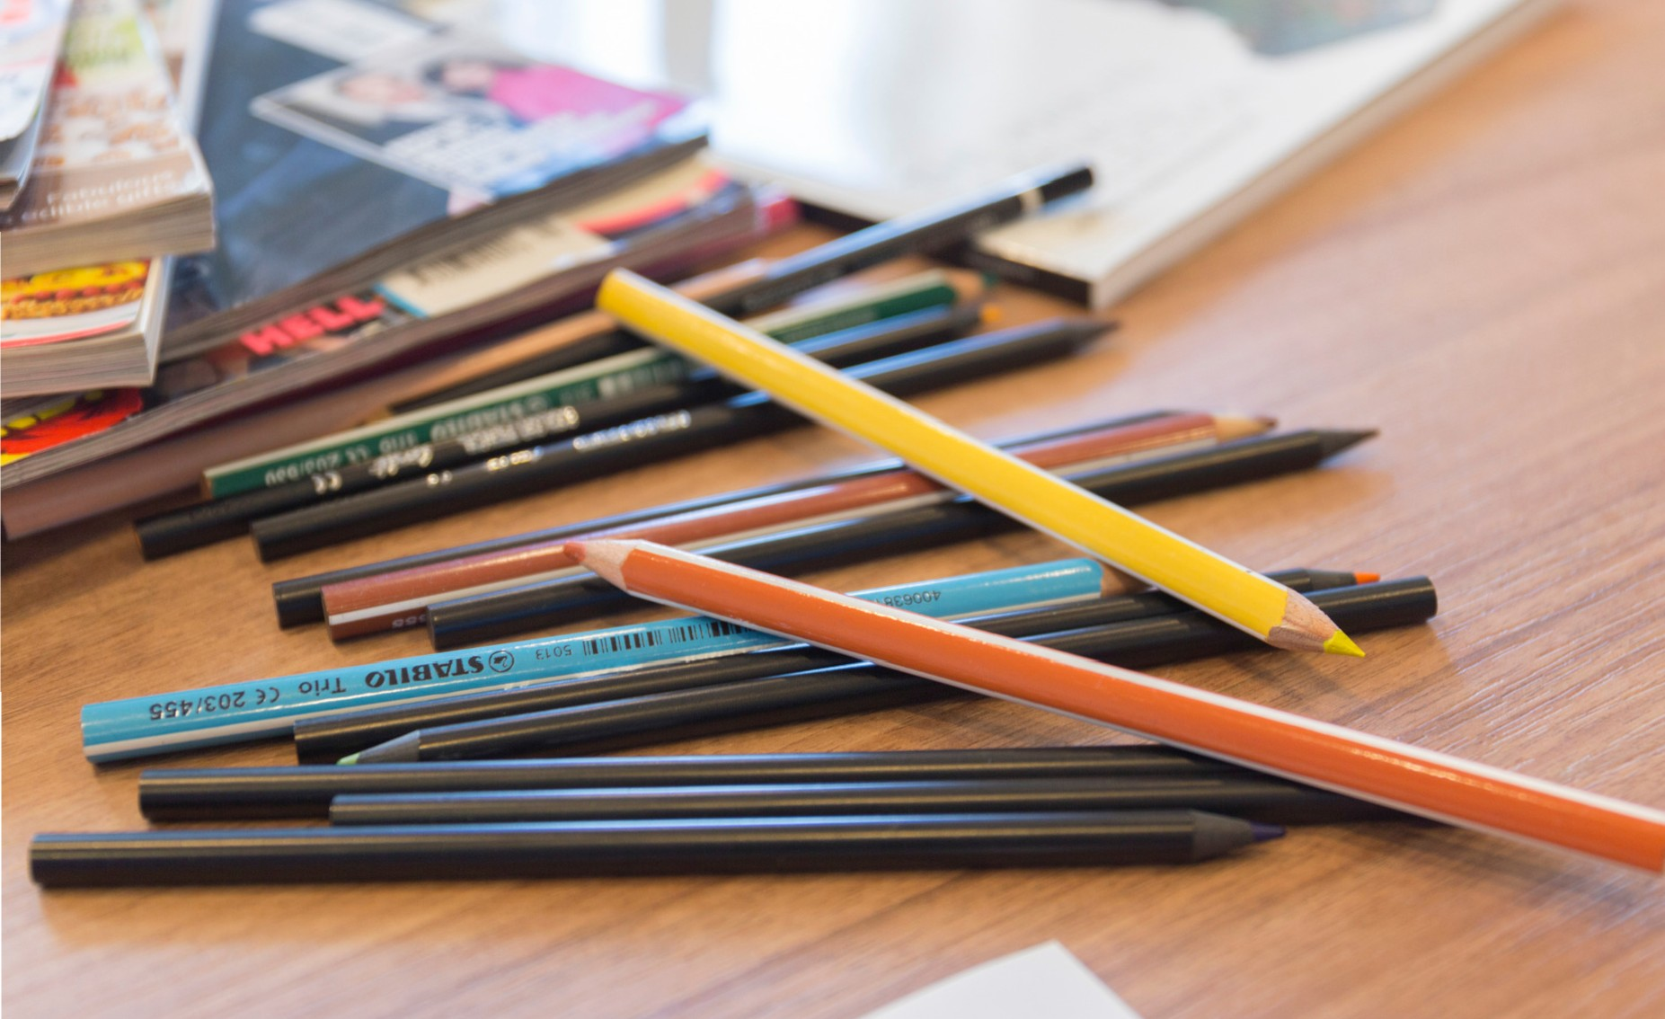
DEVELOPMENT OF THE RESEARCH PROJECT

Slide 3
M E T H O D O L O G I C A L A P P R O A C H
"The visual disarms or bypasses the purely intellectual, leading to a more authentic and complete glimpse of what a particular experience is like or of what people think and feel."
(Weber 2008)

Slide 4
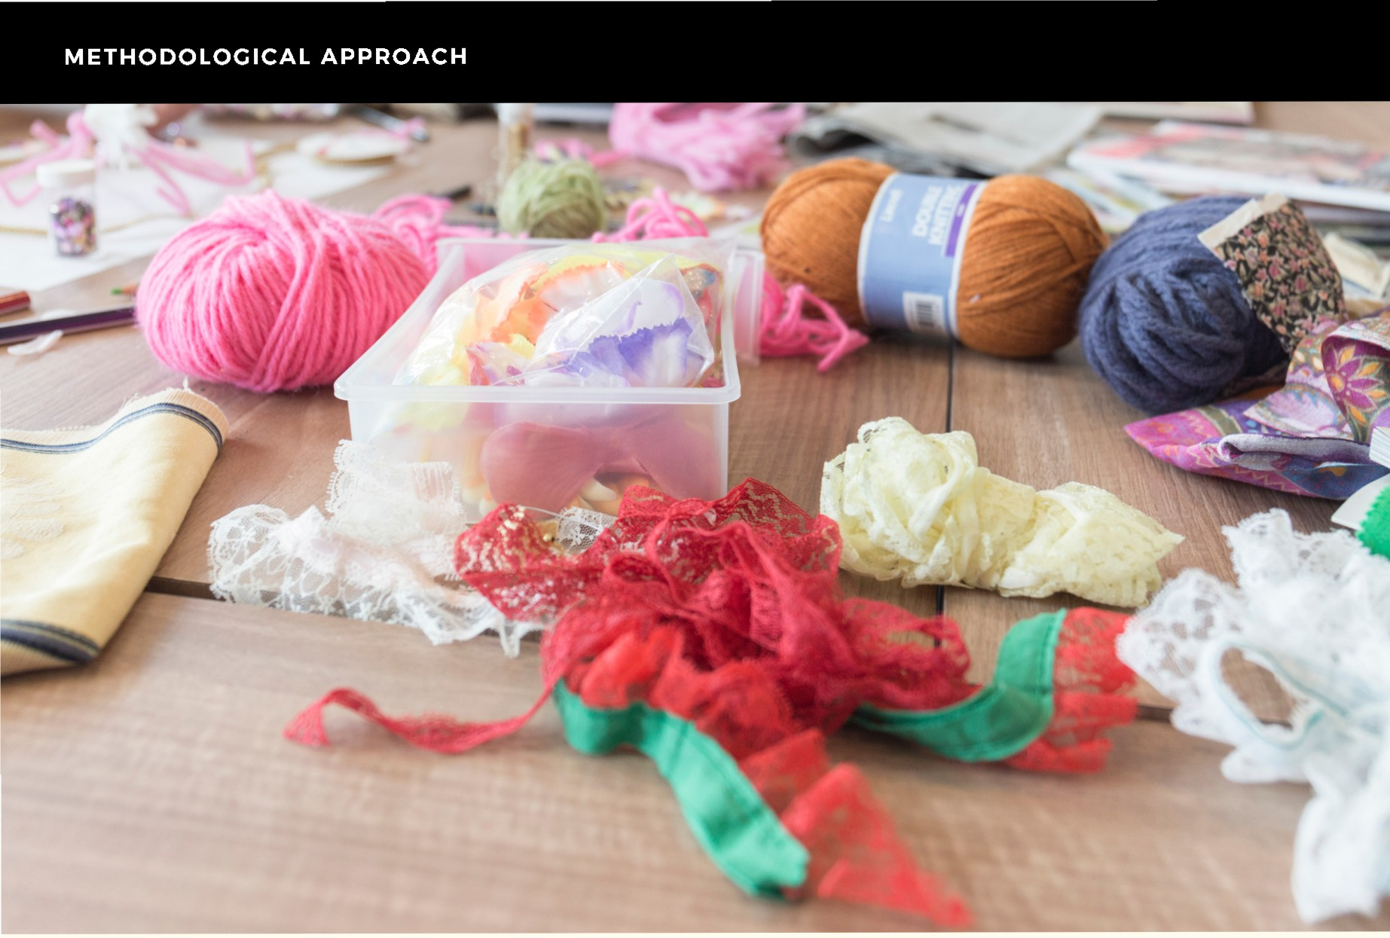
Participant-generated visual inquiry as a research method

Slide 5
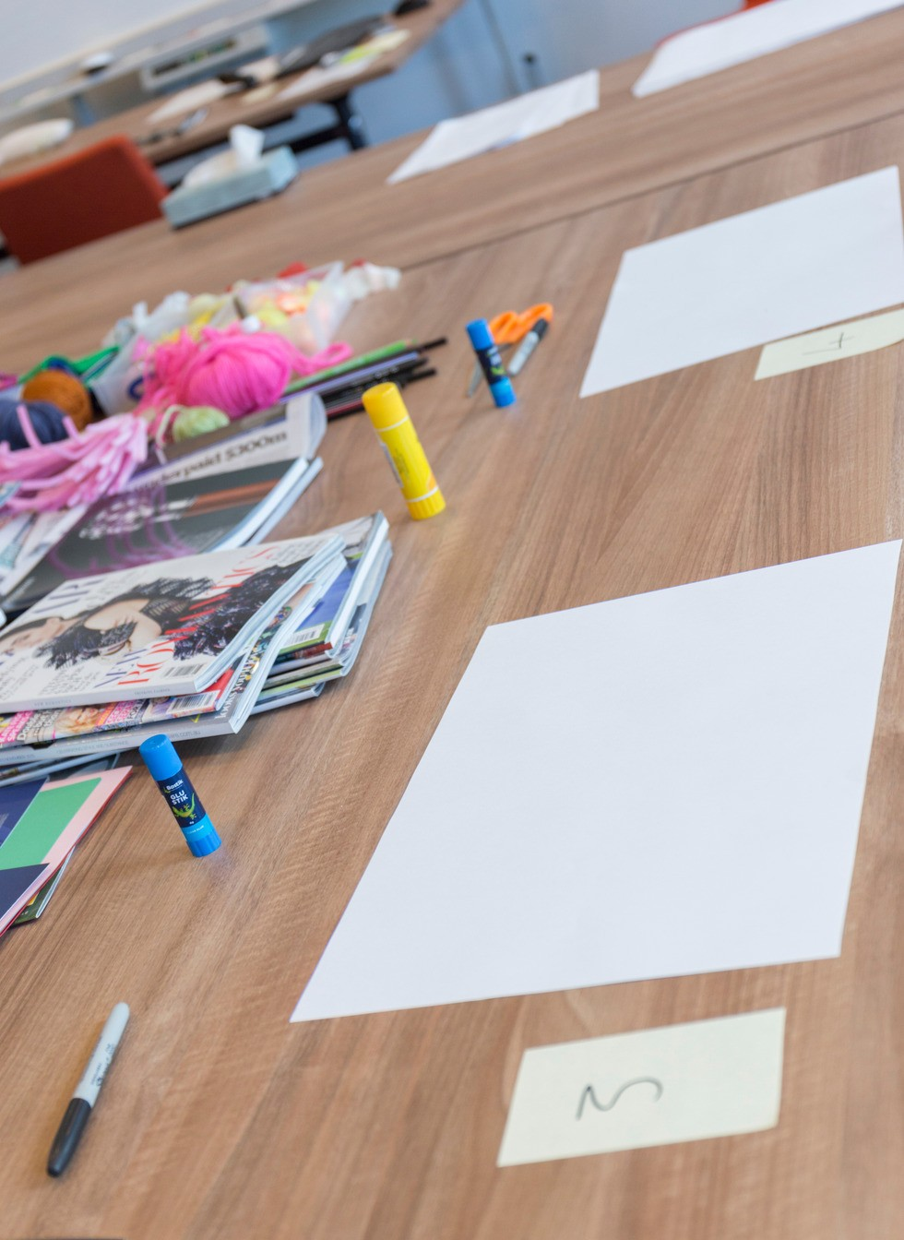
D A T A C O L L E C T I O N
Participants responded to the question... "What does the role of the liaison librarian mean to you?"

Slide 6
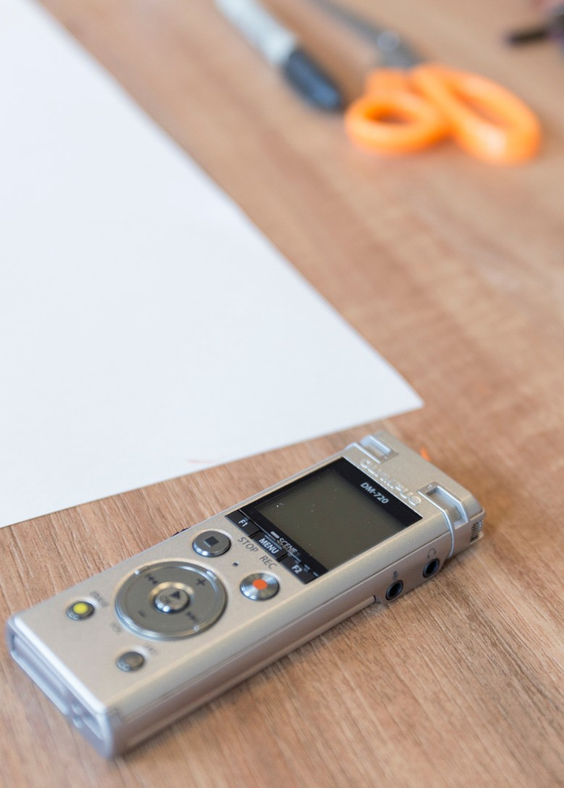
D A T A C O L L E C T I O N
"...a kind of research which enables people to communicate in a meaningful way about their identities and experiences ... through creatively making things themselves, and then reflecting upon what they have made."
(Gauntlett and Holzwarth 2006)

Slide 7
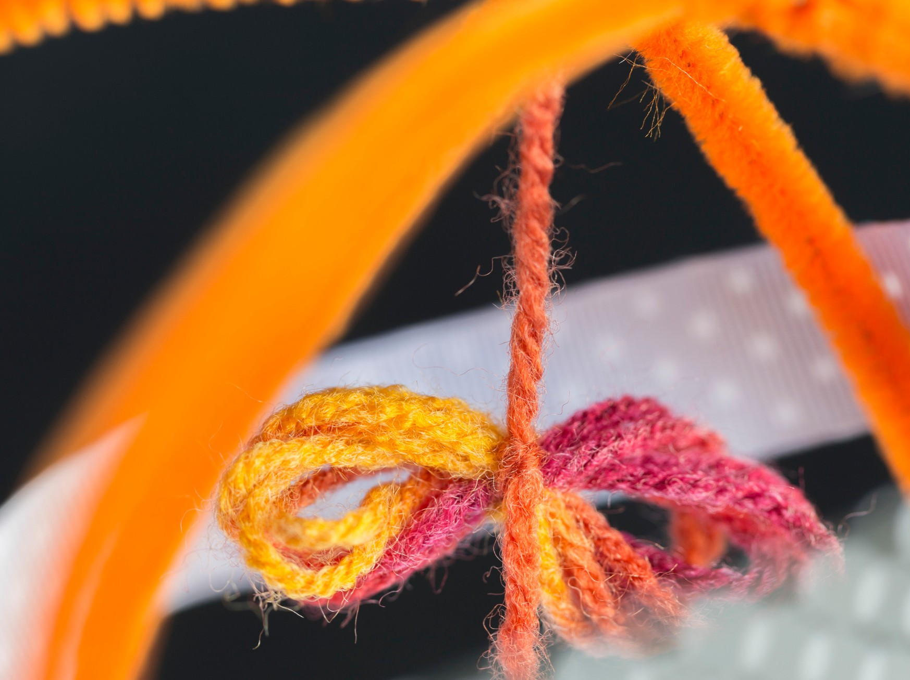
C O D I N G T H E D A T A

Slide 8
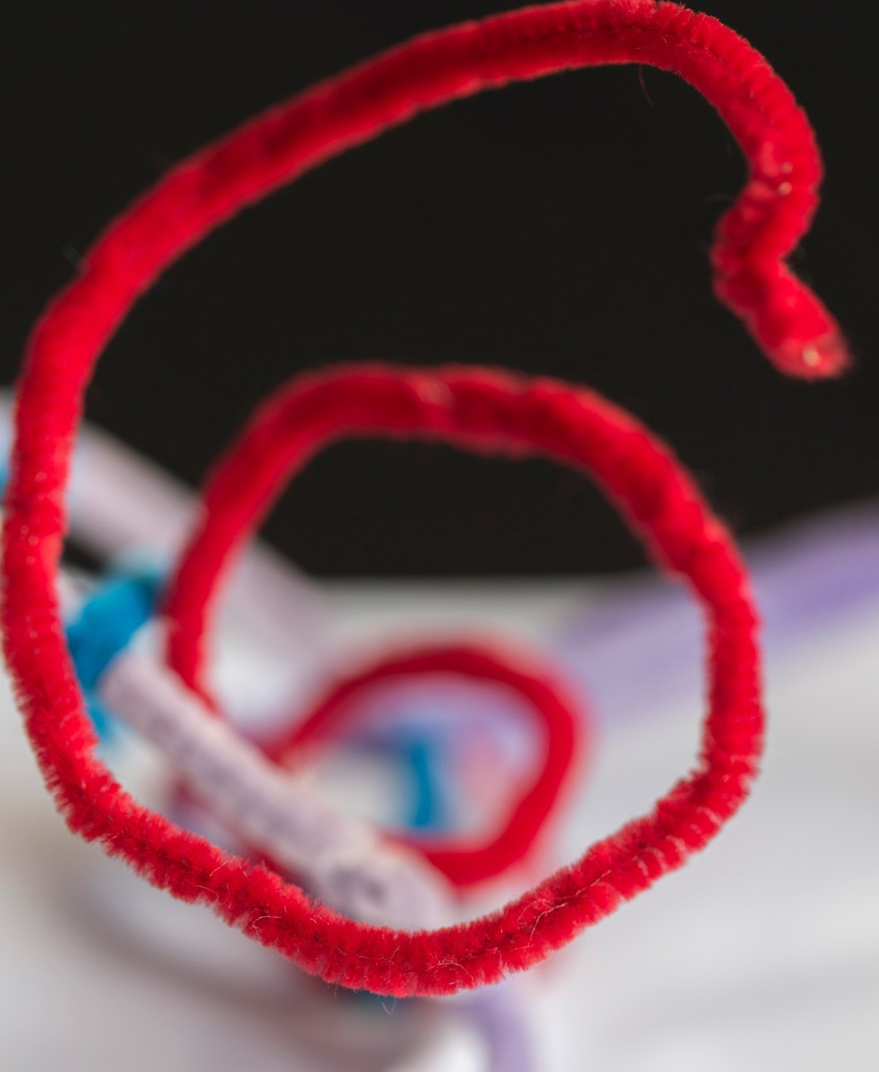
R E S U L T S : T H E M E O N E
Liaison librarians as a gateway
Access Connectors Linking Finding Guide

Slide 9
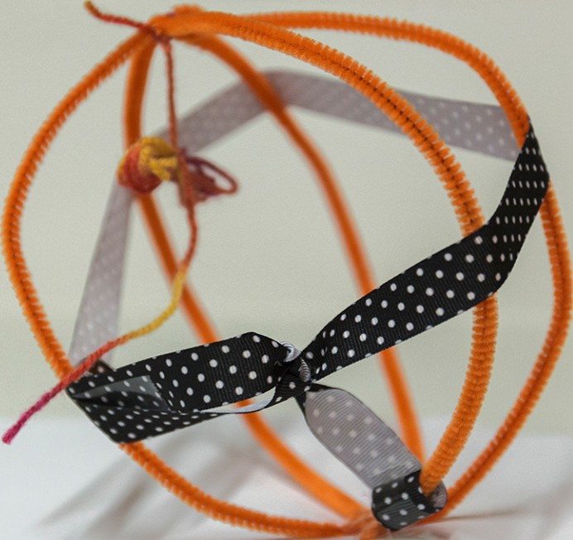
LIAISON LIBRARIANS AS A CiATEWAV
"The librarians are holding
the world,
the world of
Deakin
together."

Slide 10
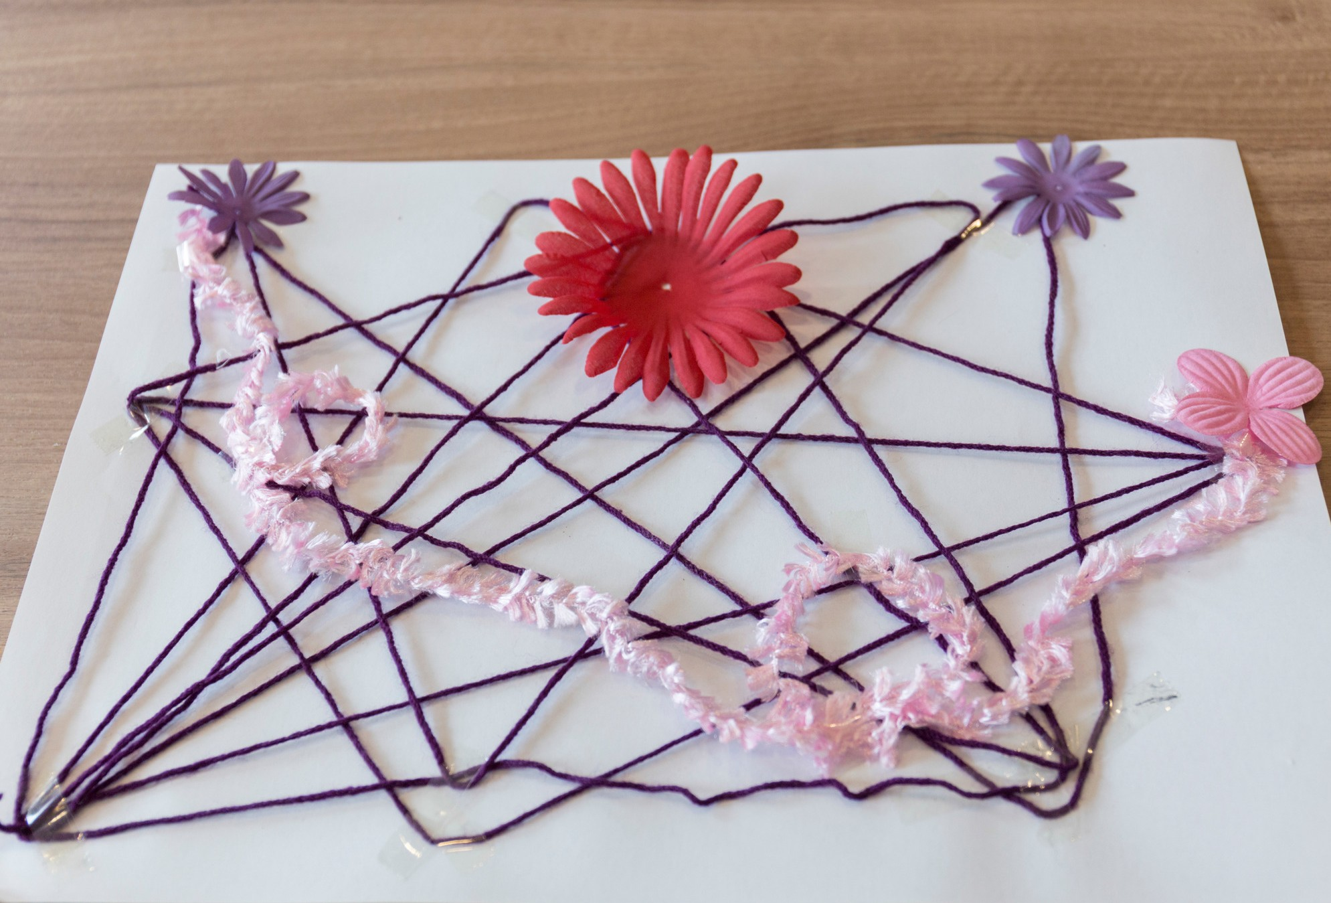
L I A I S O N L I B R A R I A N S A S A G A T E W A Y
"She's sort of the guide. Being the guide to the resources and translator of databases." Study participant

Slide 11

R E S U L T S : T H E M E T W O
The various roles of liaison librarians
Teaching
Research
Collection development
Keep up to date
Proactive promotion
Information experts
Collaborators
Support

Slide 12
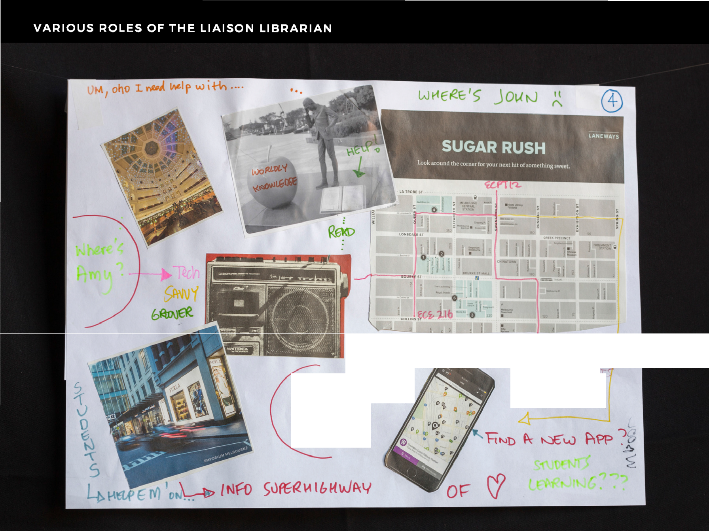

--l lv t-J uP 11'\
VOLVM {?
W ve·¹s
M (iOVt?
1
' Sf\ r
f\ !' .,-
<? ,: A Rc H...

Slide 13
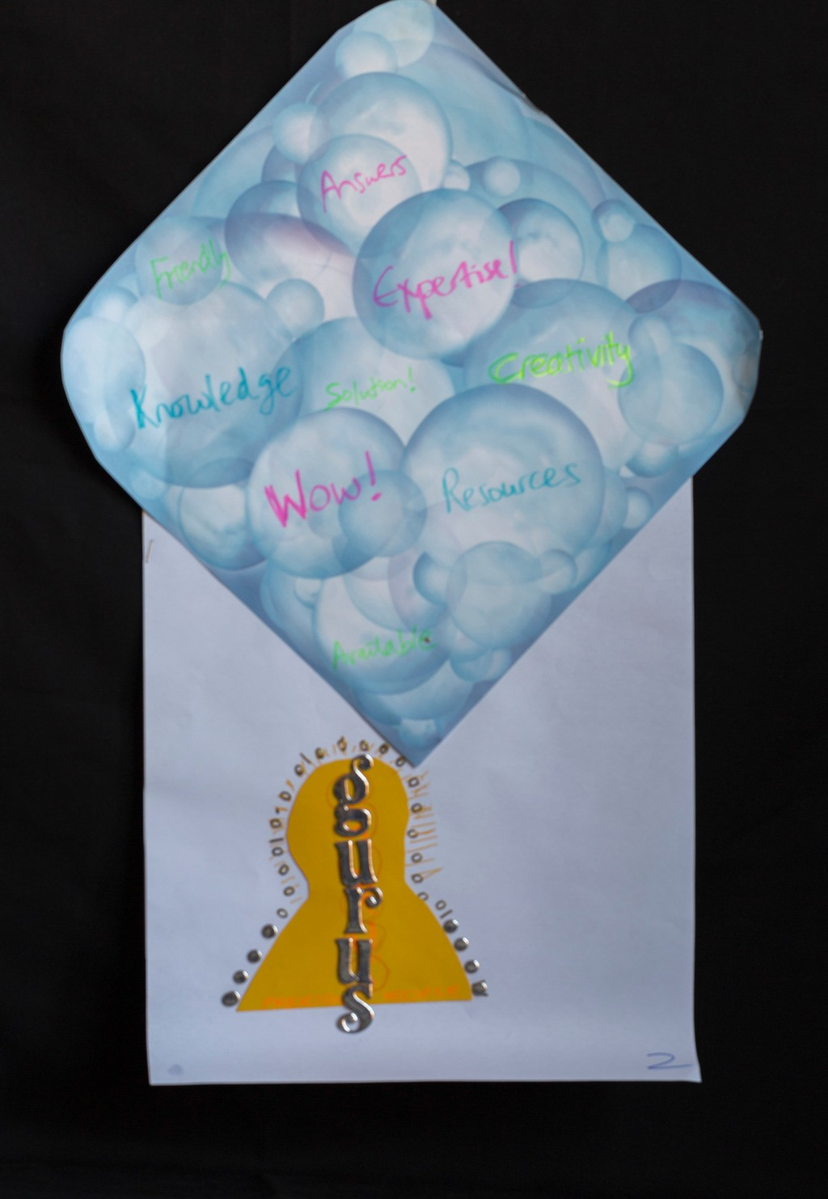
R E S U L T S : T H E M E T H R E E
L i a i s o n l i b r a r i a n s a s t r u s t e d s o u r c e s
Trust
Independent perspective Verification
Reliance on Value
Clarity/coherence Mediate
Success of clients
"Precious people." Study participant

Slide 14
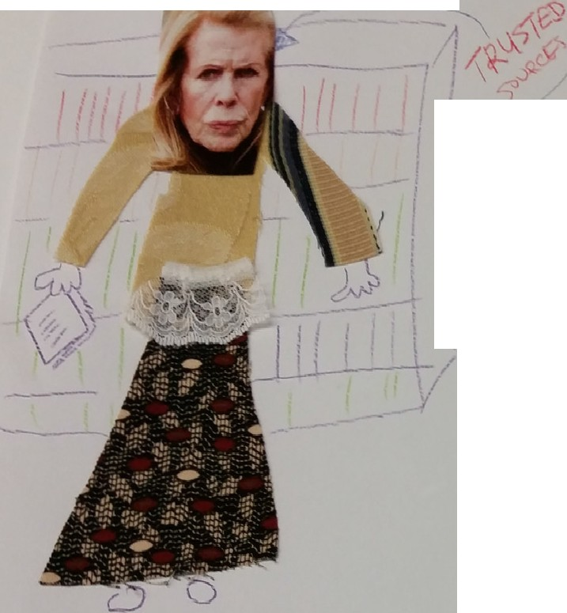
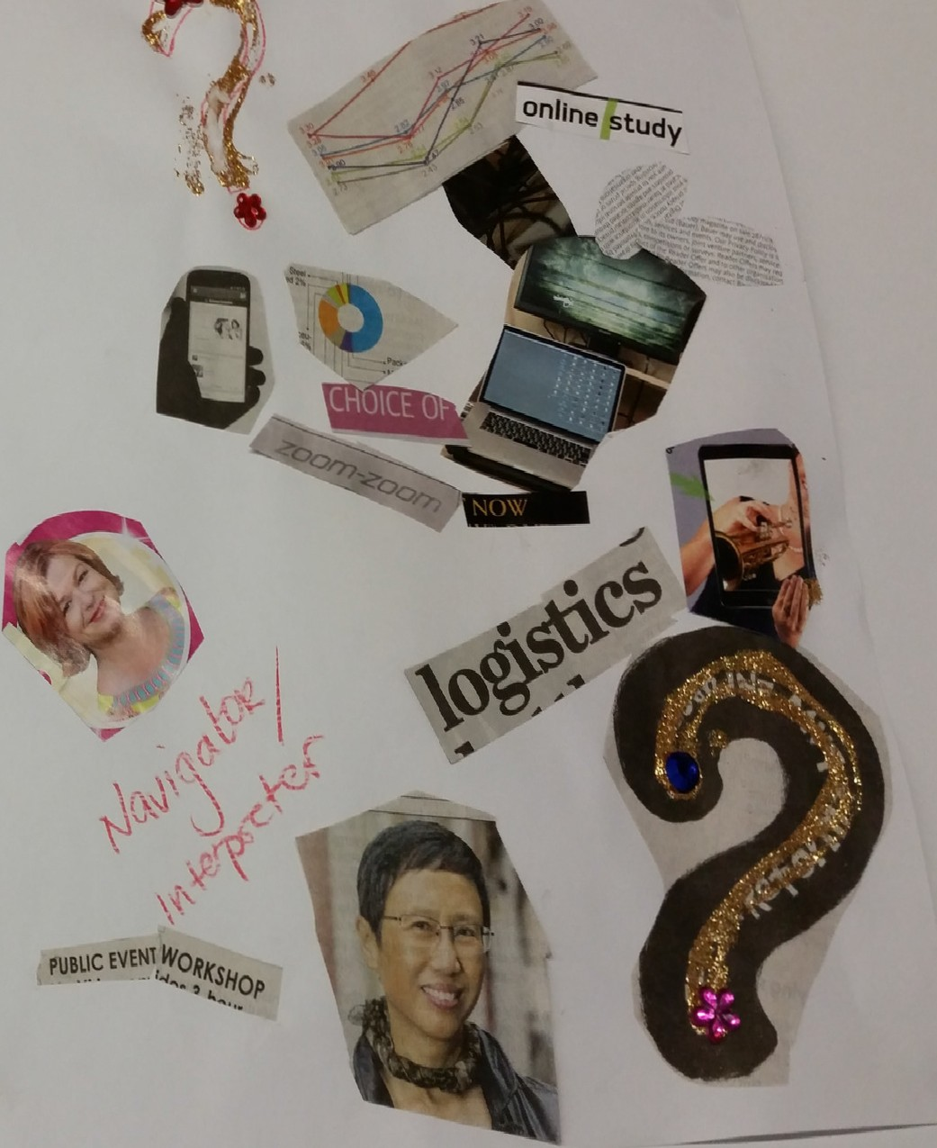
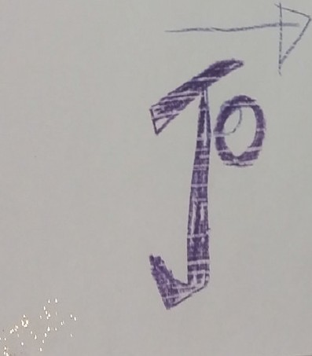
LIAI
RIANS AS TRUSTED SOURCES
;
I
i
\
I
^{f}1lTJ ^{r}-
.. /
.:-"'

Slide 15
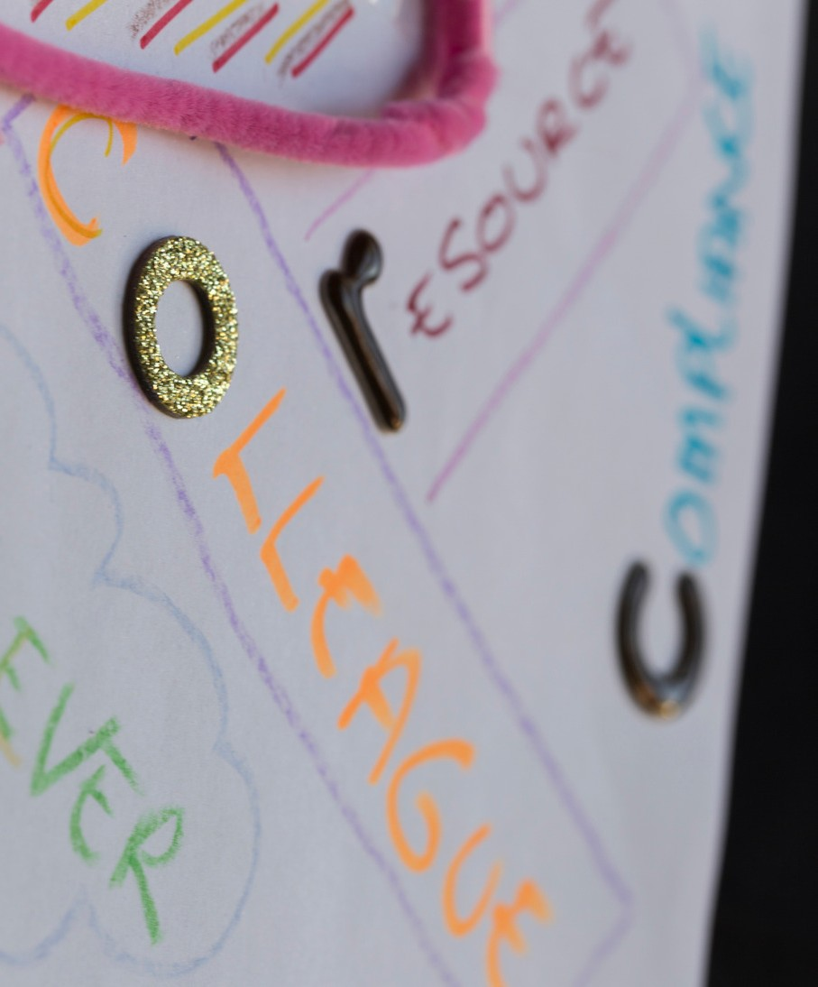
R E S U L T S T H E M E F O U R
L i a i s o n l i b r a r i a n s a s r e l a t i o n s h i p
b u i l d e r s
Interpersonal skills
Guru Friend Smart Proactive
Relationships Colleague

Slide 16
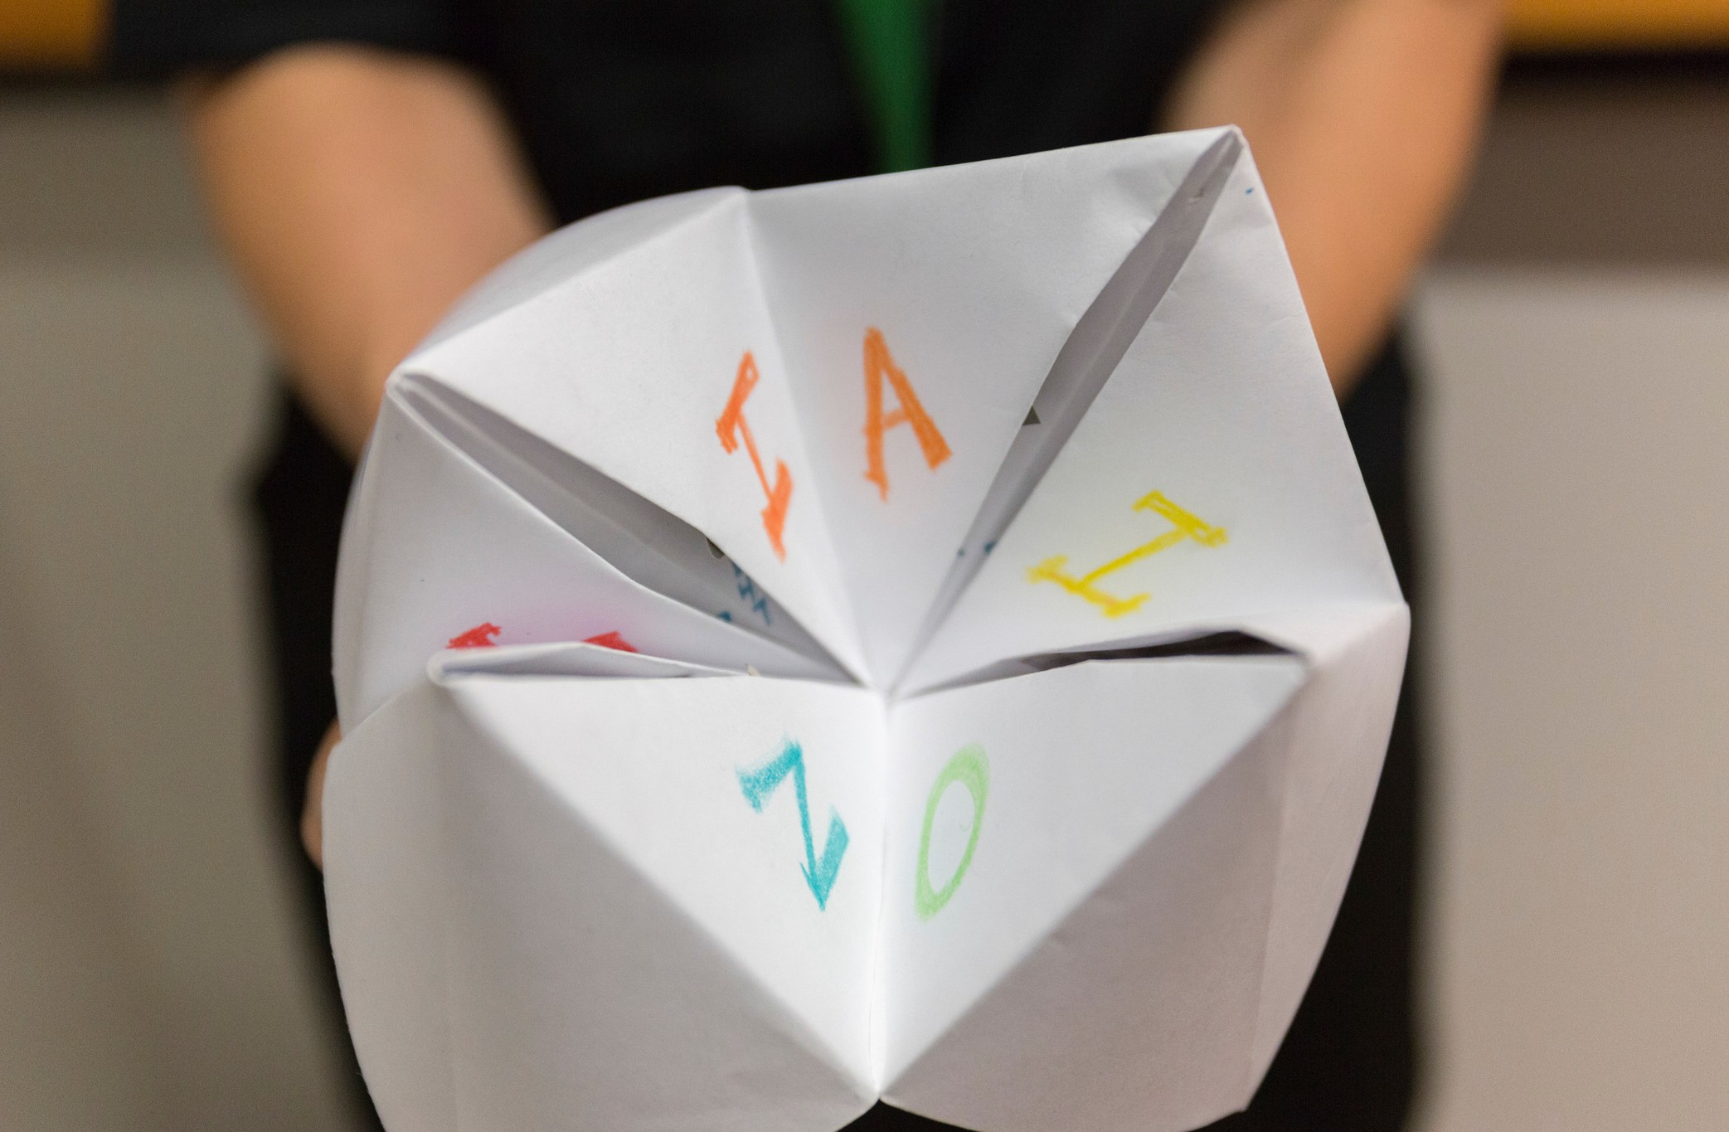
L I A I S O N L I B R A R I A N S A S R E L A T I O N S H I P B U I L D E R S
"I is for insightful. You always have the answer." Study participant

Slide 17
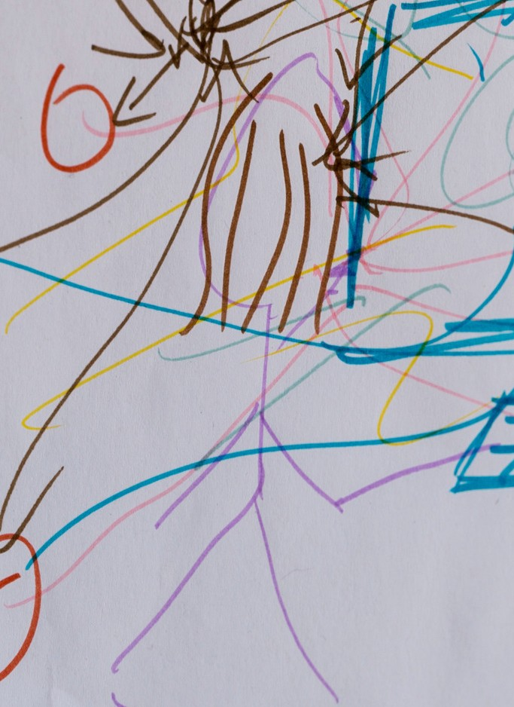
G e n d e r
R E S U L T S T H E M E F I V E
Maternal
Nurturing
Feelings for liaison librarian

Slide 18
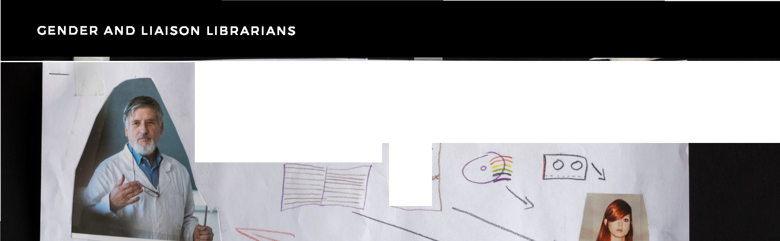

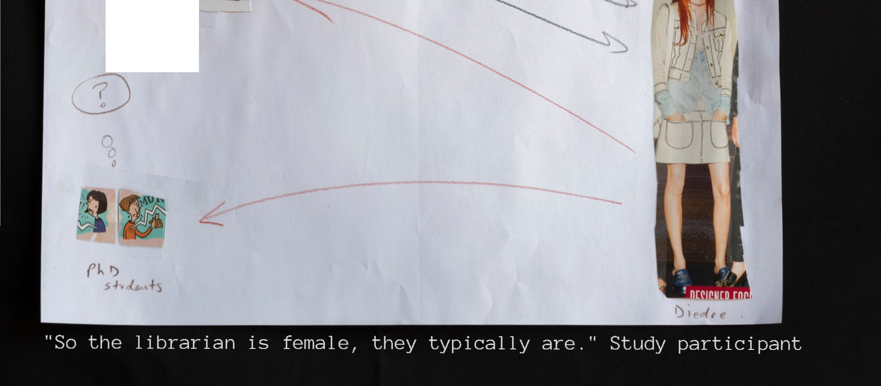
_{o} 0 () 0 c;;_{r};""''O t/
-
•
'I,,,N'V'
-:r.
1r• f#rd
l .Ms-.
ACII l)f,.. "c
t 5A ec. II t,'l:

Slide 19
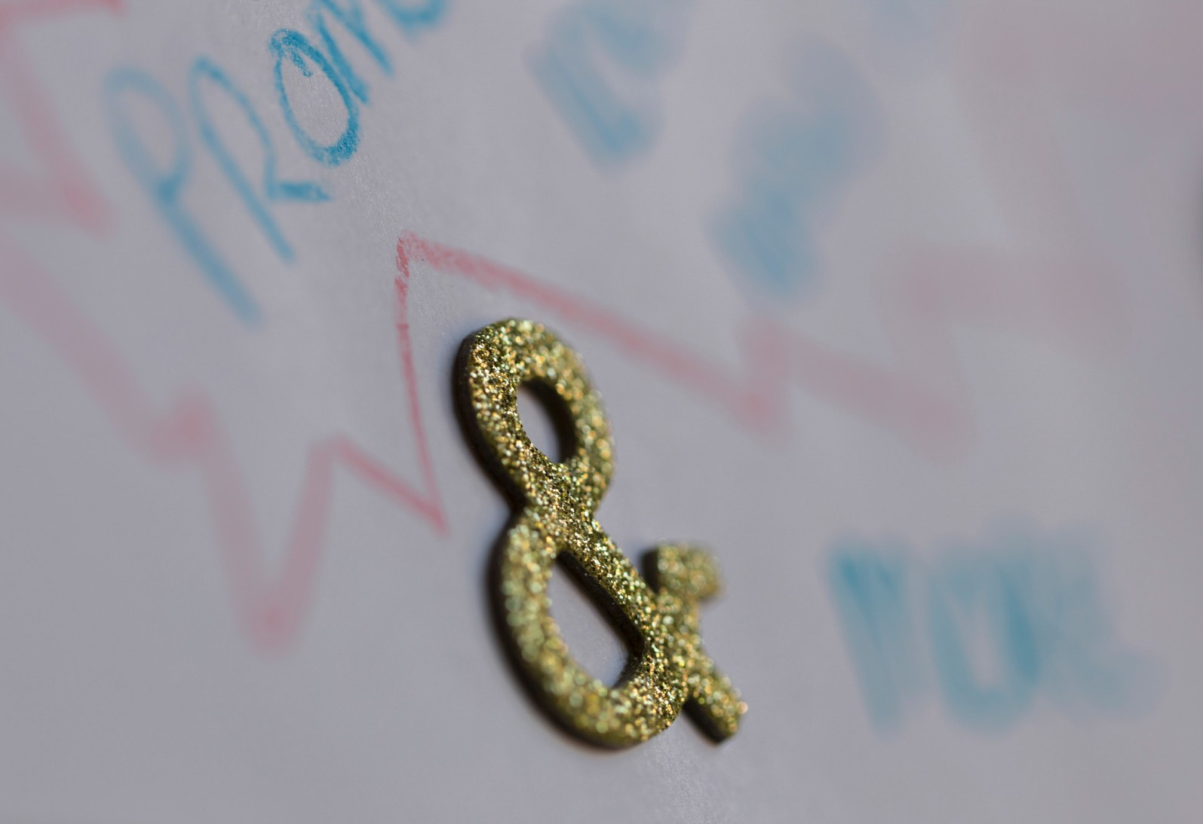
R E S U L T S T H E M E S I X
"...a person who passes on ideas. The liaison librarian is someone I could say to "this is what I have in mind."
Study participant
I n s p i r e d b y l i a i s o n l i b r a r i a n s
Ideas
Inspiration Novel ideas
Looking forward Way forward

Slide 20
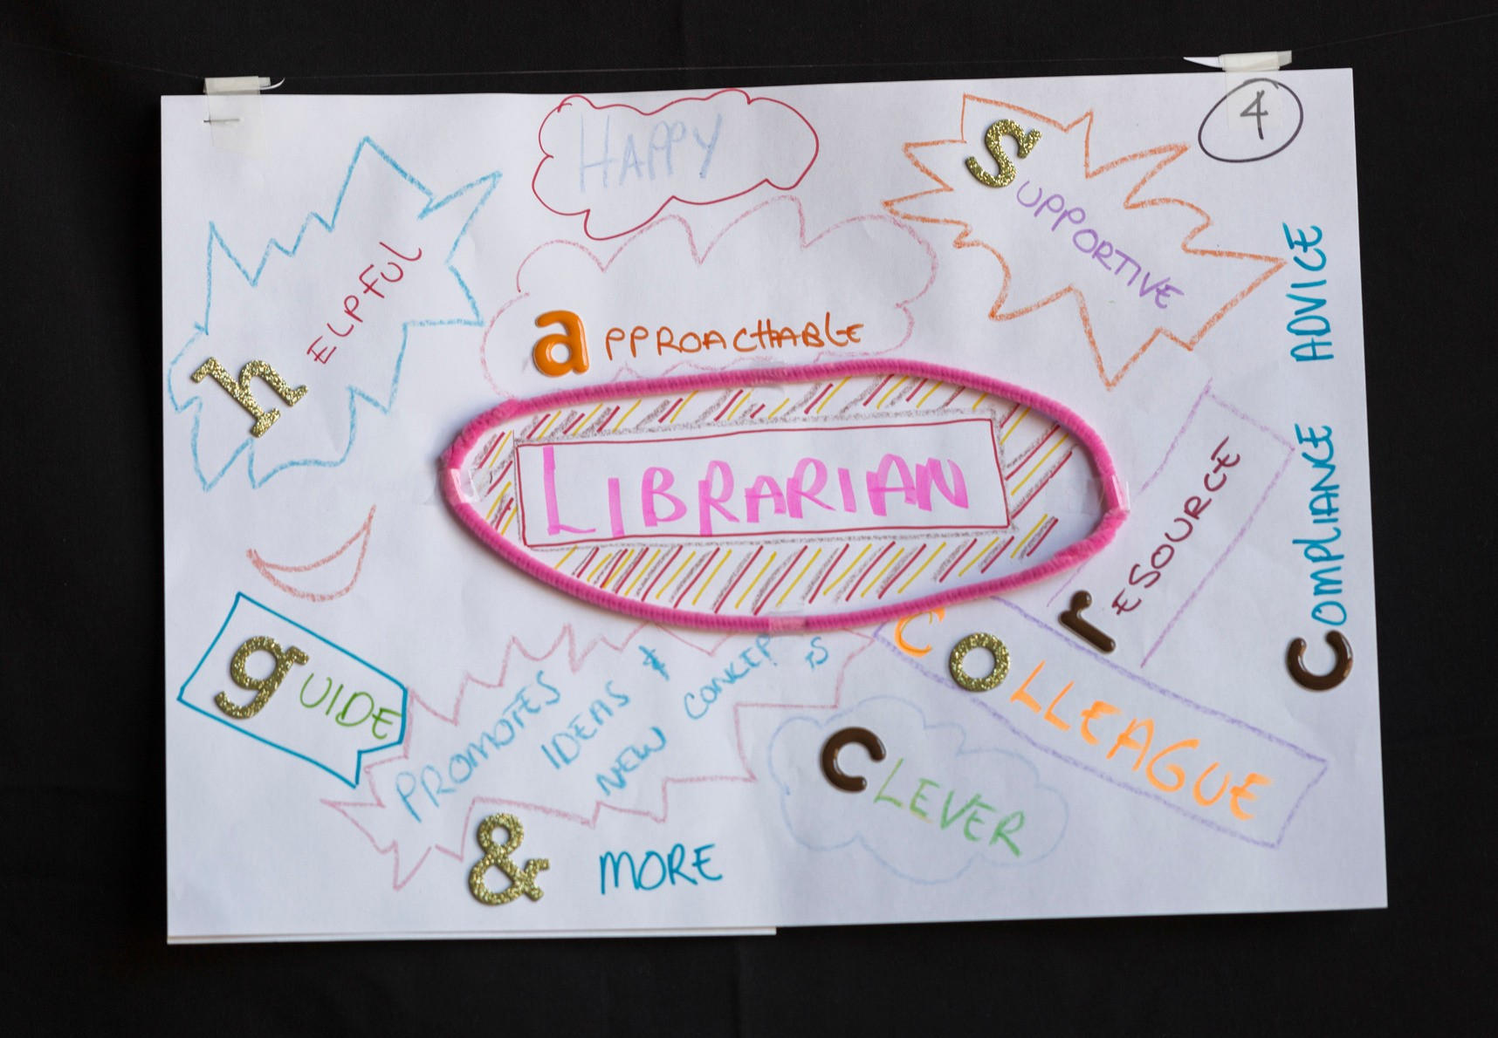
I N S P I R E D B Y L I A I S O N L I B R A R I A N S
"...a person who passes on ideas. The liaison librarian is someone I could say to "this is what I have in mind." Study participant

Slide 21





0
0
"'
0
<?0
/_
0
Any questions?

Slide 22
Image credits: Marina Minns
R E F E R E N C E S
Contacts
Deirdrie Gregory (deirdrie.gregory@deakin.edu.au) Marina Minns (m.minns@deakin.edu.au)
Josephine Le Clerc (josephine.leclerc@deakin.edu.au)
References
Gauntlett, D & Holzwarth, P 2006, 'Creative and visual methods for exploring identities', Visual Studies, Vol. 21, no. 1, pp. 82-91.
Weber, S 2008, 'Visual images in research', in J Gary Knowles & AL Cole (eds), Handbook of the arts in qualitative research: perspectives, methodologies, examples, and issues, SAGE, Los Angeles, pp. 41-54.

