Slide 2
Rickie Morey Deakin University
Sylvia Pilz Monash University
Sarika Singh Victoria University
Clare O’Hanlon La Trobe University
Clare Duffy Federation University
Mina Nichols-Boyd La Trobe University
Vivian Luker RMIT University
Gerry Fahey University of Melbourne
Question Time
Question Time

Slide 3
Rickie Morey
Liaison Librarian
Deakin University
“Isn’t digital literacy just using technology?” – How Deakin’s liaison librarians are preparing students for digital literacy in the workplace.

Slide 4
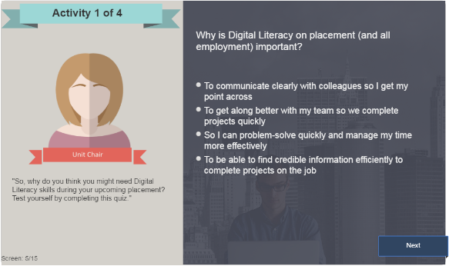
Work integrated learning at deakin

Slide 5
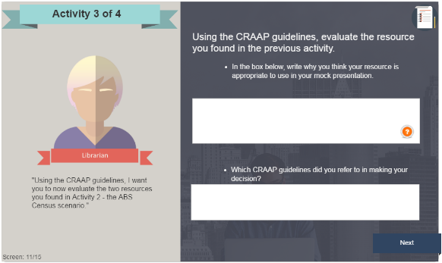
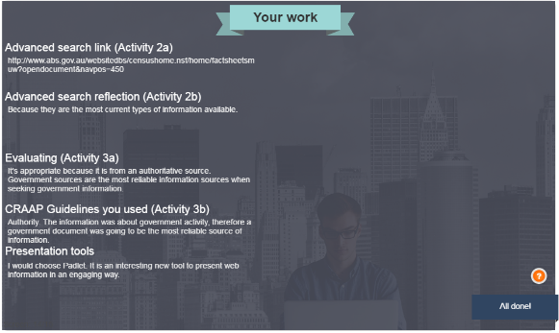
digital literacy in the workplace

Slide 6
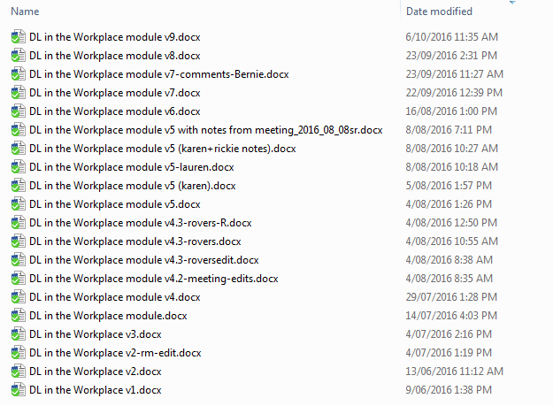
Collaboration!

Slide 7
Sylvia Pilz
Librarian
Monash University
My research journey footprint, so far...

Slide 8
http://prezi.com/hzfh13ylg07r/?utm_campaign=share&utm_medium=copy&rc=ex0share

Slide 9
Sarika Singh
Librarian
Victoria University
Evaluation of student e-book education and training at Victoria University

Slide 10
Why student e-book education was developed?
In response to a Library survey
Library’s preference to purchase e-books

Slide 11
How it was done?
Face-to-face delivery
Short 20 – 30 minute sessions
Advanced session (2016)
Resources created to support learning
Videos
Handouts

Slide 12
Evaluation of the program
Qualtrics survey tool used
Well attended in Weeks 1 and 2
Mostly positive feedback
Increase in attendance
Very professional and patient assistance provided
I found it informative, and helpful. much quicker than if i had to go and find it out myself. thanks for organising it. much appreciated
Really disappointed with myself that I missed this session! Apologies!
what was included was what i was after
it was a very nice training and I am looking forward to visit the advanced training
Liked the handout at the end and the YouTube follow up video.
…It would be EXTREMELY USEFUL if you could provide a table that summarizes all this information so people know what to expect and what is required in each situation and from each provider.
Year/Semester | Attendance
2014 | 60
2015 | 129
2016 | 166

Slide 13
Challenges
Short sessions vs extensive content
Timing and delivery of the session
Attendance – how to reach out to students

Slide 14
Looking ahead
Blended approach
Face-to-Face delivery
Online delivery
Continue creating and updating online resources to support e-books
E-book libguide
Create few more how –to videos

Slide 15
Clare O'Hanlon
Senior Learning Advisor
La Trobe University
Finding courage, creativity and community (as well as information) at La Trobe University library

Slide 16
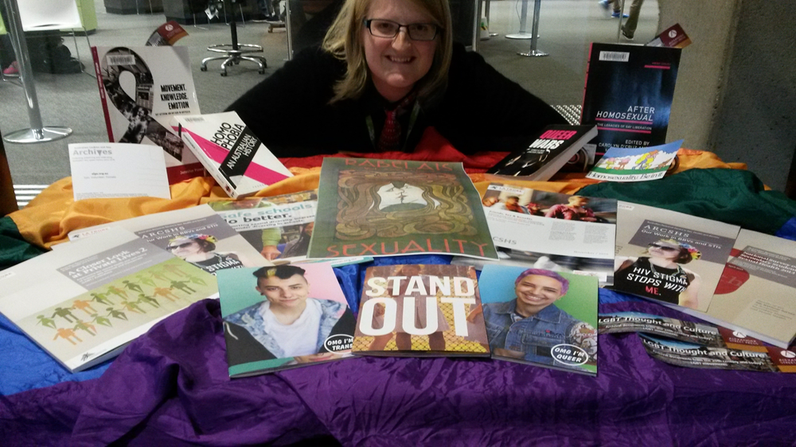
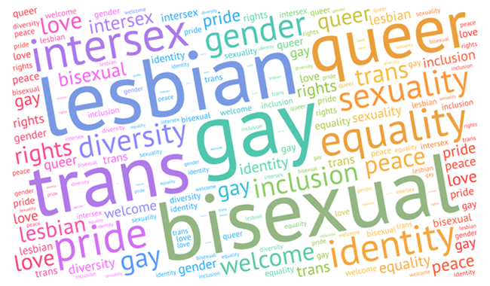
A safe place for all to connect with information and each other
Display and morning tea to acknowledge the International Day against Homophobia, Biphobia, Intersexphobia and Transphobia (IDAHOBIT), recognise the extensive work academics have done in teaching, research and engagement to promote LGBTIQ equality, and to highlight some of our relevant resources.
Demonstrating that the library is a safe and welcoming place for the LGBTIQ community on campus.
A blog post by Lloyd (2010) illustrates the power of being visibly LGBTIQ-friendly in libraries and beyond.
Open to All: Serving the GLBT Community in Your Library: a toolkit prepared by American Library Association Gay, Lesbian, Bisexual, and Transgender Round Table.
Notes:
What we did
Why we did it

Slide 17
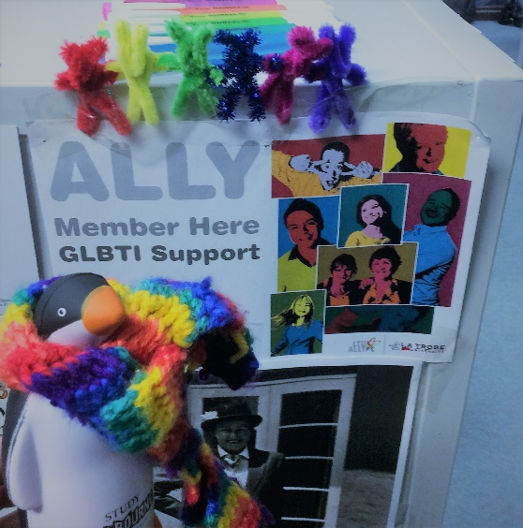
Collaboration and community engagement: “Nothing about us, without us”
Find an ally
Collaborate widely within the library and beyond it:
Learning and teaching, strategy and planning, facilities, collections and access
Queer Counsellor
ALLY network
Australian Research Centre for Sex, Health and Society (ARCSHS)
Australian Lesbian and Gay Archives
Start small
Listen to feedback and adapt
Notes:
How we did it
Top tips
Start small- – test ideas, build support, trust and courage, reflect and adapt

Slide 18
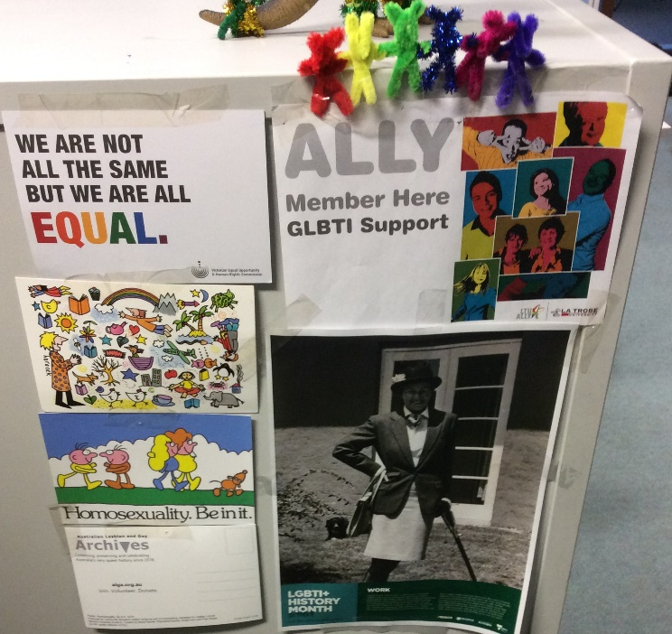
Impact and future possibilities
Positive feedback from all stakeholders
Great support from library leadership and colleagues
More library staff members have joined the ALLY network this year
Helped foster partnerships with academics in the field
Australian Lesbian and Gay Archives Committee member
More interactive
More creative approaches to measuring impact
(e.g., Farrell & Mastel 2016)
More space, promotion and participants
Notes:
What happened while it , future ideas, possibilities and plans

Slide 19
References and resources
References:
American Library Association Gay, Lesbian, Bisexual, and Transgender Round Table (2016). Open to All: Serving the GLBT Community in Your Library. Retrieved from: http://www.ala.org/glbtrt/sites/ala.org.glbtrt/files/content/professionaltools/160309-glbtrt-open-to-all-toolkit-online.pdf.
Farrell, S.L. and Mastel, K. (2016), Considering Outreach Assessment: Strategies, Sample Scenarios, and a Call to Action. In the Library with the Lead Pipe, Retrieved from: http://www.inthelibrarywiththeleadpipe.org/2016/considering-outreach-assessment-strategies-sample-scenarios-and-a-call-to-action.
Lloyd, E. (2010, October 2). Being Visibly Queer-Friendly: Please Consider It. Poesy Galore. Retrieved from: http://poesygalore.blogspot.com.au/2010/10/being-visibly-queer-friendly-please.html
Wood, L.M. (2012). Out of the Library and Into the Wild. In the Library with the Lead Pipe. Retrieved from: http://www.inthelibrarywiththeleadpipe.org/2012/out-of-the-library-and-into-the-wild/.
Connect:
Join your university’s ALLY network (or related group) and get in touch with queer student union representatives
Academic librarians and social justice group: http://socialjusticelibrarians.pbworks.com/w/page/112578373/Academic%20Librarians%20and%20Social%20Justice%20LIST
Australian Lesbian and Gay Archives
http://alga.org.au/
#Auslibchat: https://alianewgrads.wordpress.com/new-generation-advisory-committee/auslibchat/
On accessibility for a diverse community
On collaboration
On social justice (December 6th)
Explore resources from:
The Pride Library at Western University (Canada): http://www.uwo.ca/pridelib/
The Network (UK): http://www.seapn.org.uk/

Slide 20
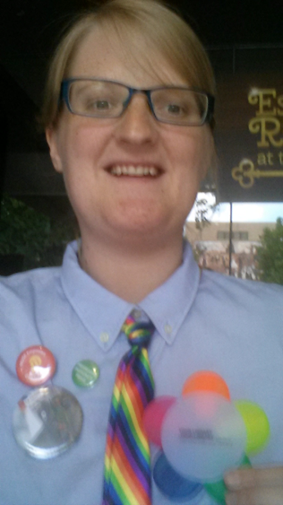
Queeries and clareification
Contact Clare:
on Twitter @clareifications
via email c.ohanlon@latrobe.edu.au
Notes:
Thank you

Slide 21
Question Time

Slide 22
Rickie Morey
“Isn’t digital literacy just using technology?”
Sylvia Pilz
My research journey footprint, so far...
Sarika Singh
Evaluation of student e-book education and training
Clare O’Hanlon
Finding courage, creativity and community

Slide 23
Rickie Morey Deakin University
Sylvia Pilz Monash University
Sarika Singh Victoria University
Clare O’Hanlon La Trobe University
Clare Duffy Federation University
Mina Nichols-Boyd La Trobe University
Vivian Luker RMIT University
Gerry Fahey University of Melbourne
Question Time
Question Time

Slide 24
Clare Duffy
Liaison Librarian (Partner Support)
Federation University
Can a Community of Practice be successful in an online environment?

Slide 30
Mina Nichols-Boyd
Senior Learning Advisor
La Trobe University
Error 404 Access denied: Accessibility in higher education

Slide 31
Accessibility in higher education
Removing barriers to access and participation for students with disabilities
Disability Discrimination Act 1992 (DDA)
DDA definition includes: physical, sensory, mental and intellectual disability
Notes:
I’m not an expert on accessibility, but I’m developing knowledge and practice in this area. Today I would like to share some of my recent insights and small changes in my own practice.
As librarians we are all about facilitating access to information and the transformation into knowledge. But, what if we are unintentionally hindering the process?
What is accessibility and why is it important in higher education? Briefly, it means providing access for people to participate in education both in physical and online settings.
Is a requirement under the Commonwealth Disability Discrimination Act 1992 (DDA) – we have an obligation not to discriminate against people with disability (physical and online)
DDA uses a broad definition of disability which includes physical, sensory, mental and intellectual disability
In relation to the DDA, the term “disability” refers to:
Physical disability
Intellectual disability
Psychiatric disability
Sensory disability
Neurological disability
Learning disability
Physical disfigurement
The presence in the body of disease-causing organisms.

Slide 32
Face palm moment (aka reflecting on practice)
Female-black-facepalm by đây chỉ là cái kho chứa hình / CC BY 2.0
Notes:
I’m part of the LibGuides working group and earlier this year we migrated to version 2. As a group we’ve made a commitment to ensure that our guides are accessible and meet the Web Content Accessibility Guidelines 2.0 (WCAG). Around the same time I was taking a subject through Rutger’s University called Learning theory, Media and the Curriculum – the subject focused on accessibility and inclusive education practice and I had the horrible realisation that I and most of my colleagues were unintentionally excluding/hindering users by not creating accessible Word documents. On top of that we were uploading inaccessible documents to our lovely new guides. Now, is probably a good time to point out that the WCAG does not technically cover Office documents. However, the Australian Government’s Digital Service Standard
Show of hands – who uses Word to create library session handouts, reports etc.? Keep your hand up if you know how to make the document accessible. Keep your hand up if you actually do make documents accessible?
Once you know this stuff you can’t un-know it – you have to do something about it!
Image by day chi la cai kho chua hi
Female-black-facepalm
https://creativecommons.org/licenses/by/2.0/

Slide 33
Quick tips
Use true heading styles
Apply alternative text for images
Use true numbered and bulleted lists
Describe hyperlinks
Describe tables
Notes:
So, while we have a legal obligation to make our resources accessible who benefits?
Well everyone, but specifically people with disabilities e.g. vision impairments, colour blindness, dyslexia.
My abstract promised tips and tricks, but I lied! Here are some tips on how to make Word accessible.
Many of the tips I’m suggesting to use are found in the Word ribbon
Other principles to follow:
Font size should be no smaller than 12 points
Provide sufficient contrast
Don’t use colour as the only way to convey content
Provide a table of contents for long documents
Use simple language
Give students options so if you are uploading a PDF also include at least one alternative such as HTML or a Word document

Slide 34
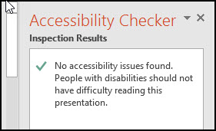
Accessibility Checker
Notes:
Microsoft Word 2010 and higher has an inbuilt Accessibility Checker that helps identify any issues. Ideally you would like to see a green tick.
Select File > Info.
Select the Check for Issues button and choose Check Accessibility.
It will show accessibility errors, warnings and tips on how to repair the errors.
There’s lots of useful information on the web if you need help with making your documents accessible. Vision Australia also have a 1 day seminar on creating accessible Word and PDF documents.

Slide 35
References and resources
Australian Disability Clearinghouse on Education and Training (ADCET). (2016). Home. Retrieved from http://www.adcet.edu.au/
Brabazon, T. (2015). Enabling university: Impairment, (dis)ability and social justice in higher education [Springer]. doi:10.1007/978-3-319-12802-3
Disability Discrimination Act 1992 (Cth). Retrieved from http://www.austlii.edu.au/au/legis/cth/consol_act/dda1992264/index.html#s4
Turner, J., & Schomberg, J. (2016). Inclusivity, Gestalt principles, and plain language in document design. In the Library with the Lead Pipe, June. Retrieved from http://www.inthelibrarywiththeleadpipe.org/2016/accessibility/
Vision Australia. (2012). Digital Access consulting. Retrieved from https://www.visionaustralia.org/business-and-professionals/digital-access-consulting
Notes:
http://www.adcet.edu.au/inclusive-teaching/understanding-disability/legislation-standards/
https://docs.education.gov.au/node/38441
https://docs.education.gov.au/system/files/doc/other/dsp_evaluation_report_final_june_2015.pdf
http://www.latrobe.edu.au/statements/accessibility

Slide 36
Vivian Luker
Reference Librarian
RMIT University
Chatterbox: 460% increased usage of an Ask a Librarian chat service

Slide 37
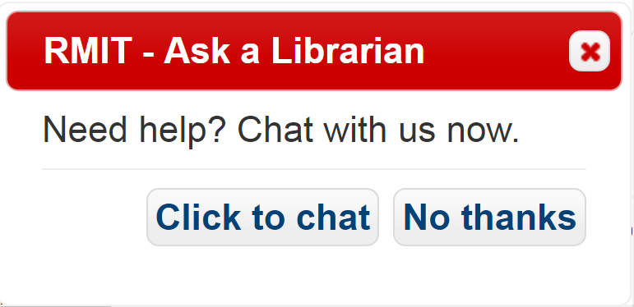
How we increased usage of Ask a Librarian chat by 460%

Slide 39
26% Service enquiries
21% Complex research advice
32% Known item searches

Slide 41
Direct access to local information professionals, not triage.
Tailored skills and local knowledge of our own Library staff will always be the best fit for our users’ needs.
Semester one 2017?

Slide 42
Gerry Fahey
Liaison Librarian
University of Melbourne
A foot in the door with ORCID

Slide 43
A foot in the door with ORCiD
Team strategies to develop a relationship with the Faculty of Science – a two steps forward, one step back approach
Background:
2015 – whole university change process, new liaison team formed, staff changes in Faculty.

Slide 44
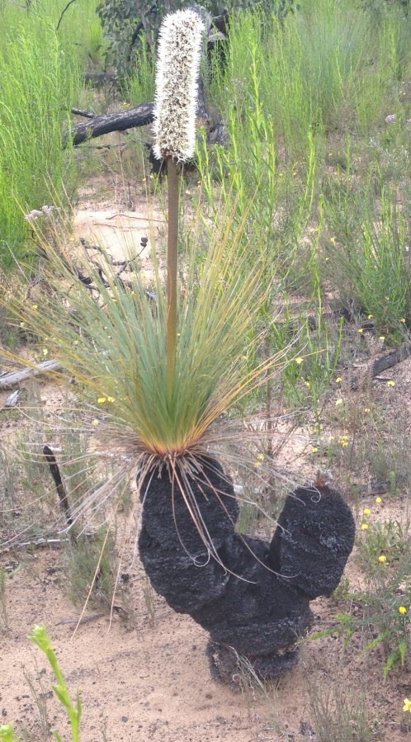
A foot in the door with ORCiD
Opportunities:
Time of change – Whole University change process
Liaison team members came with existing relationships
University mandated ORCiD for RHD Theses submission
Faculty Research Offices realised importance of ORCiD for Researchers

Slide 45
A foot in the door with ORCiD
Knock on as many doors as you can
Persistence (kept following up with Faculty contacts)
Confidence (we knew we had something of value to share)
Timing (looked for optimum time to make contact)
Multi pronged approach
Icons made by Freepik from www.flaticon.com

Slide 46
A foot in the door with ORCiD
Outcomes:
Trusted Advisors
Ongoing involvement in ‘Faculty publication health checks’
Multiple requests from key Faculty staff for reports and benchmarking support – SciVal
Image: http://charlcie.blogspot.com.au/2012/05/two-steps-forward-one-step-back.html

Slide 47
A foot in the door with ORCiD
Take home:
Look for opportunities - even in times of crisis!
Identify stakeholders
Keep contact and keep contacting
Keep contacting
Say ‘Yes’ to any invitation & be flexible
Communicate and coordinate as a team

Slide 48
Question Time

Slide 49
Clare Duffy
Can a Community of Practice be successful in an online environment?
Mina Nichols-Boyd
Error 404 Access denied: Accessibility in higher education
Vivian Luker
Chatterbox: 460% increased usage of an Ask a Librarian chat service
Gerry Fahey
A foot in the door with ORCID

