Slide 1
Getting your message right:
Developing scripts and storyboards for cloud concepts
DEAKIN UNIVERSITY LIBRARY
Christine Oughtred - Manager, Digital Literacy Programs
Rebecca Carruthers – Learning and Teaching Librarian
Notes:
Introduction:
Who we are and what are our backgrounds.
Deakin University Library has invested a lot of time and resources over the last two years in developing cloud concepts to support our course enhancement process. From our first video for academics defining digital literacy to a suite of ‘Getting Started’ products currently in development, it has been quite a journey.
As with most libraries we are moving from videos which are essentially recorded tutorials to pithy cloud concepts which are less than 3 minutes long. We feel as if we have learned a lot and we hope to share some of that experience. This is part of the training we have run for liaison librarians at Deakin to emphasise the necessity to confirm the need and then prepare a full script and storyboard before embarking on the process of creating a cloud concept.
The aim of today’s training session is to ask and answer some questions which might help you better develop your ideas prior to producing a video. We hope it might also make the process of production a lot simpler.

Slide 2
Keeping your audience’s attention
What is your message?
Who is your target audience?
What are your audience insights?
What are some considerations for:
- online learning?
- engagement in an online environment?
Notes:
What is your message?
Be clear with what your message is – BEFORE you start writing
Who is your target audience?
Different audiences have different needs and want to be told different pieces of information.
It is often hard to cover all audiences in one communication.
What are your audience’s insights?
Do you know something about your audience’s behavior/s that might influence their communication needs or how receptive they are to communications?
For example, are they time poor? Do they respond well to instructions? Are they cynical of ‘another’ communication?
What are some considerations for online learning and engagement in an online environment?
There are a few important guidelines to keep top of mind when creating these videos.
- Five minutes spent online is equivalent to half an hour in the classroom.
- Don’t leave your audience asking questions at the end, there is no direct way for you to answer these, unless you intend to provide online support.
- Don’t do too much; break your content up into realistic and appropriate sections. If the title of your video is “How to tie a shoe lace”, then people expect you to get to the point.
- Your video might not be a stand alone resource – don’t get trapped into covering too much in the video – you could create a suite or package or different resources.

Slide 3
Why audience and key message considerations are important
http://www.youtube.com/watch?v=Iv8bkYKbMo0
Notes:
Queue to 3mins 10 sec
A short video from the Gruen Transfer, illustrating how audience and message considerations are two of the most important things to think about first.
(This might help set the tone for the session too. We want it to be fun and memorable and make sure people understand, in context, why these things are important.)
Show videos and allow for some discussion following them, we might ask for some ideas around:
what made the videos so engaging
what did you notice about the target audiences and
can you identify any in particular,
Did you recognise who the key messages are and can you name a few?

Slide 4
The development process:
Identify the need
Create objectives
Write script(s)
Translate into a storyboard
Notes:
Now we will use these points to talk through a recent example of the development process.
Our concept checklist

Slide 5
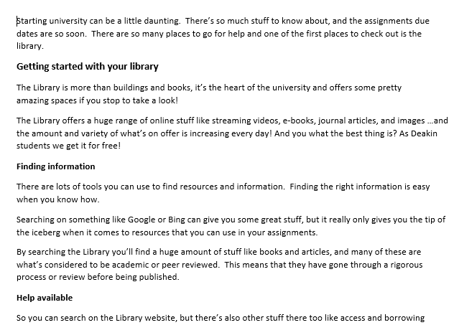
Getting started with your Library:
Script
Notes:
For the Getting started with your library video…
We already had a prezi which we use in intro classes, along with a “getting started” webpage. This concept was to combine the key concepts from both the prezi and the texty webpage. Feedback was that the content was great for orientation, and if we had a video, it would save Liaisons from going over the same information, and also allow for off campus students to get the same information.
We pulled key messages from both documents. Our audience had already been id from the original documents, so we focused on presenting this information in an engaging and accessible way.
Several drafts of a script were shared and refined, before consensus was reached.
The scripting process, which was not a full time task, took 3 weeks (approx. 6 full days for scripting and redrafting after feedback) by the Learning and Teaching Librarian

Slide 6
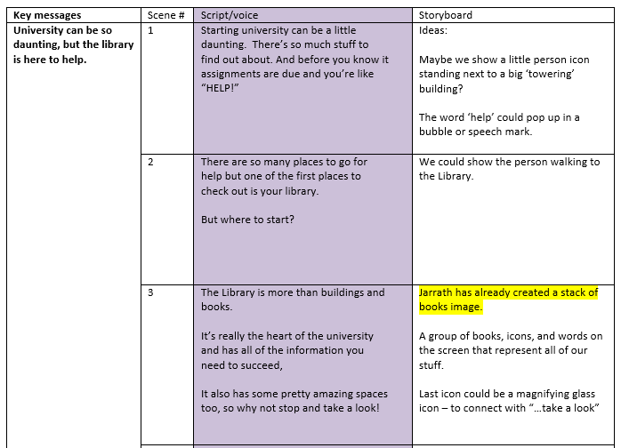
Getting started with your Library:
Storyboard
Notes:
For the Getting started with your library video… cont.
Storyboarding process was a team effort between ourselves and the library communication team who would then develop the visuals for the video. We are lucky enough to have a communications team who specialise in graphics and animation.
This process took approx. ½ a day to complete
The next phase was graphic design, animation and recording of narration which took around 2 weeks full time for one specialist staff member.

Slide 7
Getting started with your Library:
The finished product

Slide 8
Answer these things first:
1. Who is your target audience? (what’s their age? background?)
2. What are your audience insights? (what do they already know, how do they like to receive information, etc.)
3. What are some considerations for:
- online learning?
- engagement in an online environment?
Notes:
Now a chance for your to have a go writing a script. This is a fun task to apply some of these points… please open your envelopes.
There is a template on your table. Remember to answer the key points first and then move on to the script.
5 mins prac on identifying your audience

Slide 9
Things to remember when writing a script
Tone and language - remember your audience
Be accessible (No tech/library speak)
Be concise (No fluff)
Read it out loud
Notes:
TIP: Maybe create an outline – dot points of what to cover / key steps and then flesh it out
15 mins prac on scripting
5 mins reflection on the task of scripting

Slide 10
Storyboard development
(we learn from the best)
https://www.youtube.com/watch?v=QOeaC8kcxH0
Notes:
Walt Disney studios originally developed storyboarding.
Can you imagine 10 illustrators spending hours drawing and painting 50 frames of animation to only be told to edit what they had done because the wrong character was in frame?
Or the background wasn’t what the director had in mind? Developing the storyboard enabled all the illustrators to know exactly what was to be drawn and scene on screen at any given time. This saved time, resources and frustration.

Slide 11
Why storyboard?
It’s your roadmap or blueprint
You can get feedback on your concept or idea
It makes more sense of your idea
This whole process may help you produce something worth watching.
Notes:
The storyboard is your road map for what you think you’ll end up producing. It’s your blueprint. It means you know what you’re about to produce without doing any of the work of filming or recording.
Your storyboard allows you to know what will be shown on screen for each scene of your video. It will help you flesh out your ideas; this is where your words come to life. You will discover if what you have written in you script will translate to film.
It also means that if you need to get approval or feedback on something in your concept, you can easily show someone what it might look like, and get feedback and make changes without having to do any recording or editing, this is your ‘draft’ stage.
When you draw out each frame of your storyboard it doesn’t have to be an amazing illustration. Make sure you write what part of the script goes with what frame as to eliminate confusion.
You will use your storyboard on the day of filming; you can use it as a shot list and reference. This will also help when it comes to editing your footage.

Slide 12
Things to remember when storyboarding
Have engaging visuals
Remember your audience
You don’t need to be an artist
Now create some storyboard ideas to go with your script
Notes:
Have engaging visuals, change it up - not just head to camera or just slides
Remember your audience – don’t be too out there – they need to understand the images you use?
Guide through the storyboarding template
10 mins storyboarding – descriptions of images

Slide 13
From storyboard to screen
Animation tools: - PowToon
Apps: - iMovie - Explain everything

Slide 14
Time for discussion
What can you see as road blocks to making videos?
What processes are you currently using from idea to product?
Notes:
Reflections
What process:
Our checklist for cloud concepts
Our staff involved to make sure the project happens – LL to L&T to captioning

