Slide 1
Professional online communities
Adele Walsh
10 November 2020

Slide 2
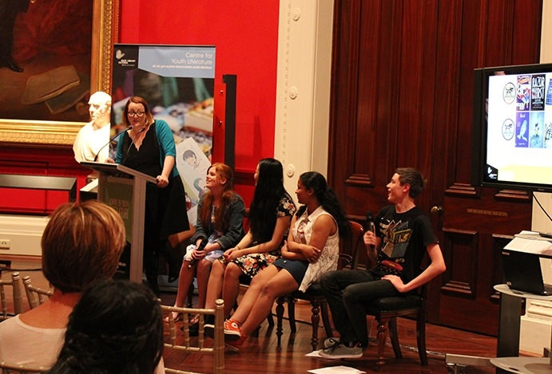
Notes:
Where I started?
So this is me a few years ago in my role as the Program Manager of the Centre for Youth Literature at State Library Victoria. When I arrived in that position in 2011 the entire program was centred on legacy programming for librarians. The conference, the quarterly sessions and newsletter were all directed at their loyal audience. And that loyal audience was no longer so loyal – numbers were dropping.
In my first few years there we pivoted away from that model and started investing in opportunities to put teens in the driver’s seat. Or as we came to call it #teenstothefront – a reference to the Riot Girls rallying cry of the 90s. If we, as an industry, the teacher libs, the public libraries, the publishers, the creators, the teachers were to truly engage young people in literature….we should probably listen to them and have that perspective gloriously infiltrate every decision, every program and every priority that we set.
In the time I worked at CYL, I managed upwards of nine social media platforms for two account personas. Staffing was typically 1.6 EFT but by the end of my time in that team we had grown exponentially. It was not rare to answer upwards of 500 professional queries a year as there wasn’t much professional steer for teen librarians and we were the only place to go.
But in all that work there wasn’t an online pd community. Accidentally I had created that around myself and ‘my brand’’. I read a lot about teens – YA releases, teen psychology, research, what’s hot on Netflix for the younger set, and even lurk on Tumblr to see what pop culture is hot rn. Even better it helped me understand the language of our audience.
I discussed this this on Twitter or in the occasional presentation, but there wasn’t a proper funnel for this knowledge.

Slide 3
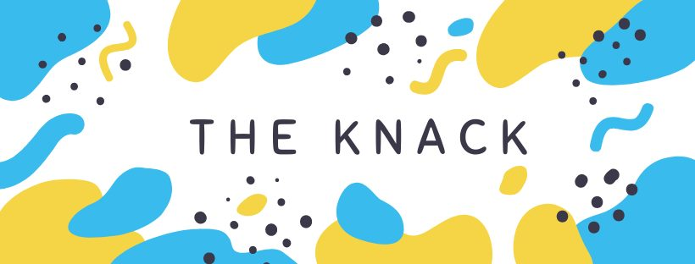
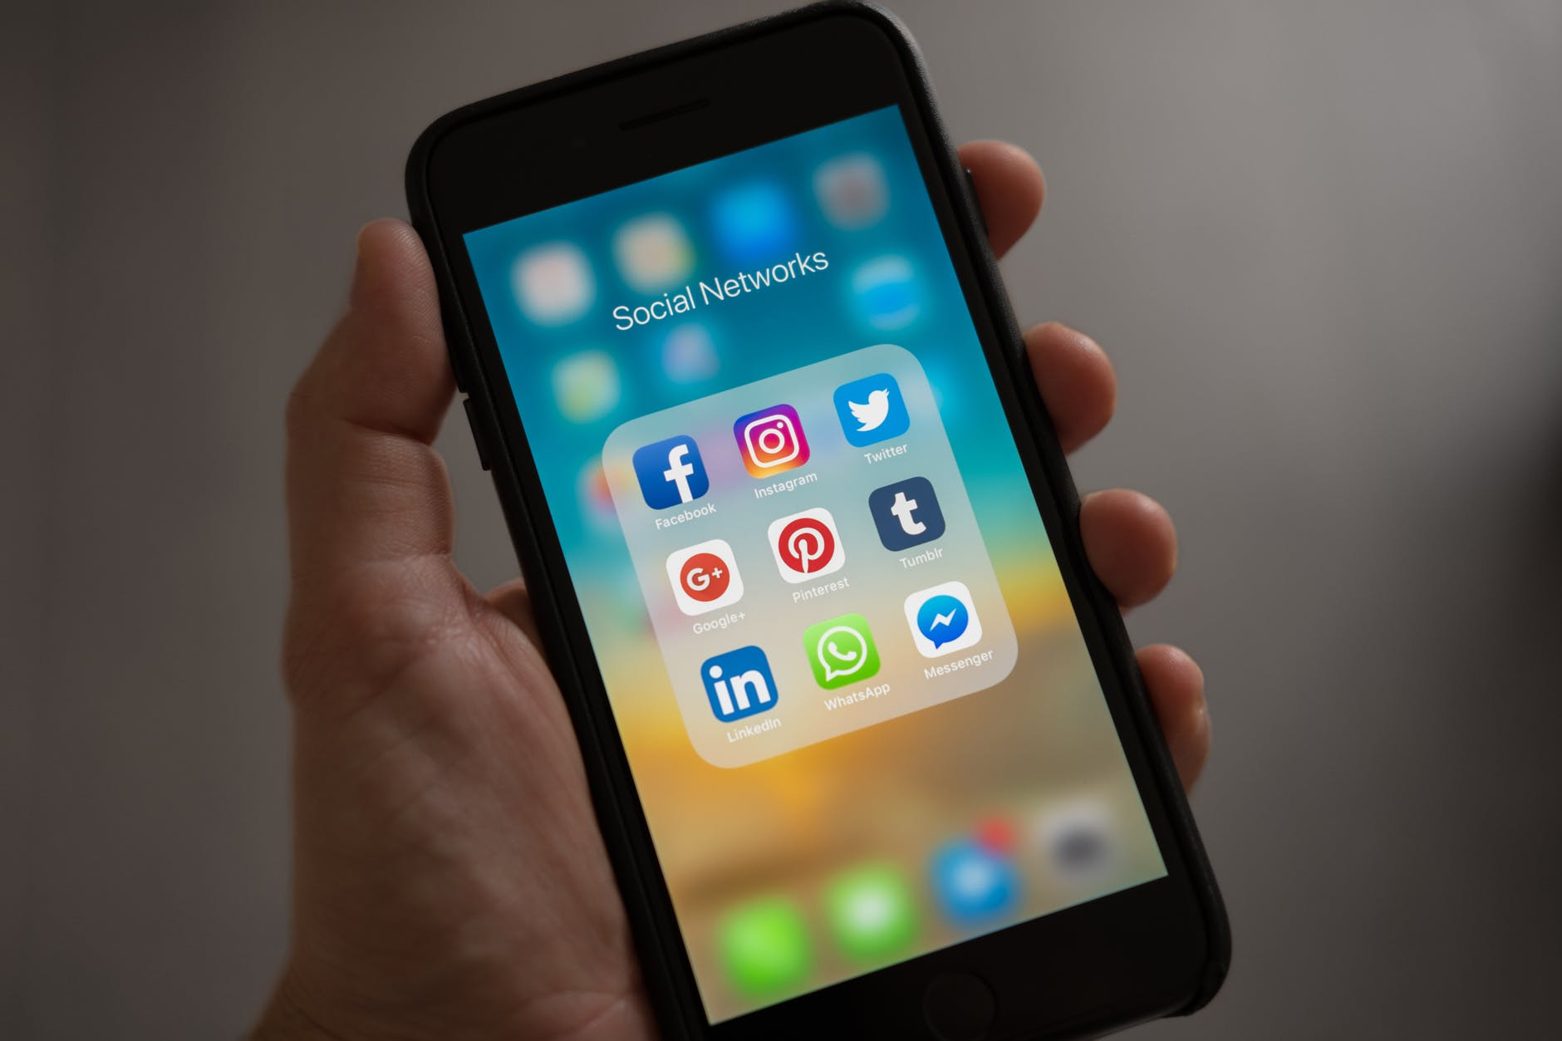
My online
spaces
Notes:
To back track a little I have been on Twitter since 2008. I actually owned the @Adele handle for a hot minute before I decided that was too obnoxious and settled on the equally obvious snarkywench, referencing my previous YA blogging life. Twitter was the place I did whatever I want – except swear. And my approach to Twitter hasn’t changed all the much – unfiltered Adele on equality, industry, pop culture and Maggie my greyhound.
In mid 2018 I decided I was going to start a monthly newsletter to aggregate all the amazing resources that I came across in my professional reading. And to fill that professional support gap. What I do for myself for fun suddenly felt selfish to keep to myself. Immediately I had 500 people sign up (thanks Twitter). And almost as immediately, I realise the format didn’t meet our collective needs. And then I dithered for a few months trying to make it work instead of recognising that I got something wrong.
At the end of 2018 I pivoted to Facebook and I’ve been steadily growing since then. We’re close to 500 but that’s not the point. The point was to create a safe progressive space for youth literature professionals who wanted to be proactive in their professional practice and growth. And I wanted it to be a practical place that focused on things to read, ideas to try and how to respect teens. Professionals who work with kids don’t have much time – they want to read something quickly, apply, asses and move the heck on. I wanted to make their lives easier.
Not just library focused, or school focused, or author self-promotion but on everything related to the shared audience – not our job titles or the industries we work within but the community we serve. And its an international perspective – and I don’t mean US by that – I make sure we’re looking further than our backyard. And when we are in our backyard we’re thinking inclusively.
And it has been that. The Knack – was to try new ideas and more importantly be open to new ideas. And mess around in uncomfortable truths that we find difficult to discuss.
And there’s some things I learned straight away –
Keep the copy short and sometimes you don’t need it because the link does it for you
Remove the html as soon as the previous appears – create white space in the post, make it accessible, make it inviting not cluttered
Ask an open question – invite thoughts
If I want to contribute to the convo – I write a comment response, puts me amongst my community
Analytics don’t lie. Friday 8pm is the hottest time? Okayyyy.
During the Black Lives Matter protests I saw the biggest spike of engagement in our community. I was posting resources three times a day, typically from the US, because Australia wasn't producing the resources or training. And with me volunteering the work that could be done and where they could start was a way I could happily contribute and not create labour for those most strongly affected by this injustice. We’ve built enough trust in the community that people were volunteering what they’ve found useful, what they’ve learned and how they’ve grown.
I asked the members a few months ago what they’ve found most useful:
‘You post a lot of content that is just out. So I learn things through here quicker than I would have found on my own. It helps make me think beyond my own personal relationship with YA and how programs should work in a library setting ie. actually catering for their target audience.’
‘…the breadth of information shared and conversation starters that go beyond YA lit and focus on YA as an audience and as a demographic worthy of professional consideration and effort.’
‘I'm wanting to make sure I stay abreast of what's going on with YA lit so that I can keep putting great things in front of my students.’
What I learnt from The Knack in rejuvenating my workplace’s Yammer.

Slide 4
Continuous Learning
Notes:
PROFESSIONAL COMMUNITY
Katie and I conceptualised what a ‘learning community’ might look like practically. We wanted to foster the continuance of conversation after PD sessions had concluded and ensure staff who couldn’t attend live could watch on demand, and still be part of the conversation.
There was a pre-existing social/professional reading Yammer group for library staff prior to my team’s creation but we soon saw the opportunities in adding to this online community. In February we recognised it’s importance in our larger professional development program and how it could be a place to share experiences, ask questions and make recommendations.
We were already working towards this when it became clear that COVID was about to be an issue, and we stepped up our plan to encompass wellbeing as well. With the staff flung to every corner of the state, we wanted to ensure there was a content plan (particularly in the early days) to foster connection and a little frivolity.
When you think about an online community, people talk about it occurring organically or unstructured. But…You need a structure, particularly a content plan initially to test what members respond to and change it up accordingly. We found out that pet photos and recipes worked at the beginning….and that’s not really the case at this point. Community needs and energy ebb and flow, you need to read the room and change with it. If people are flat, putting lots of content on Yammer is overwhelming.
Immediately following each session we send out an email with the recording link, slides, survey link AND a link to Yammer. In following this link our staff would see a post by the presenter that asks attendees to discuss how the topic relates to their lives. It’s convivial and relaxed, and more important voluntary. And while it doesn’t’ always work – it sometimes helped to consolidate the learning, leverage collective wisdom, and recognise and validate expertise amongst our staff.
Results – active members grew 94% since January. I believe most if not all staff are in the group at this point. And reactions to posts have grown nearly 3000% in that time. What’s even better is that we don’t need to post to a schedule anymore as the community take care of that. This past 48 hours there was a call out for funny tv recommendations, a link to a pronoun resource, and a report of the Waterfowl University Rankings in which the LTU’s ducks didn’t do so well.
A PD community isn’t just formed around the morning tea menu or on twitter. It can be created within a single post on Yammer over and over again.
Working alone together – trying new things LinkedIn and Reflection

Slide 5
What can we learn from public libraries?
Community
Advocacy
What libraries can learn?
Communications and marketing
Notes:
WHAT CAN WE LEARING FROM PUB LIBRAIRIES?
The Creative State strategy here in Victoria showed that libraries were barely on the radar.
Librarians typically are not great advocates for ourselves or our industry.
Scratch that, we’re kinda terrible.
Public Libraries Victoria launched their ‘Libraries Change Lives’ campaign nearly three years ago and were able to build on the momentum of that work with important council and state govt advocacy this year. While it would be easy to dismiss this piece of work as promotional, their network underwent considerable training in storytelling and tools to help strongly capture the anecdotal successes and community impact. University libraries could learn from this. Regardless of which uni we’re affiliated with, we are all in this together. What would a community look like with a common goal? Do we have a standard # to spruik our wins and celebrate and boost each others?
Another thing we could learn from public libraries is to take the library to them. There is a temptation to make library use about the space – whetjer physical or digital….but what about taking the service to them? A few years ago I heard of an Auckland library which took items of their collection out to a bar, chatted about what was in tonight’s selection of titles and matched attendees to books while they all had a lovely drink. It was called Read Between the Wines and it was a solution to the problem of younger professionals not being able to get to the library within opening hours to search and borrow. What does it look like when academic libraries step outside of the campus? What can we upend? And where’s the best space to share the successes and failures?
We can also learn that we don’t have to do it because everyone else is…. digital storytimes were everywhere. Do we need to replicate something or can we promote it for them?
AND WHAT CAN LIBRARIES LEARN IN GENERAL?
I would love to see more open innovation – sharing our failures with each other.
To find the middle ground with marketing teams. In nearly every library environment I have worked within or heard about – there is tension. I’ve even heard it dismissed as ‘style over substance’. Library copy is can be quite dry and tends to remove voice. Librarians understand the audience and their needs but not necessarily how to write good copy for that audience.
Marketing people know how to write to an audience and the tools to get an audience. I suggest we need to work harder together to respect expertise and create better content. Seriousness doesn’t equate to respect. We need to be warm, approachable and consistent with our content creation….and this is only going to become harder as resourcing becomes more strained.
Build it and they will come….no - design it together and they’ll bring a friend. We cannot assume we are a proxy for our users, we need to ask great questions and be prepared for challenging responses. This will result in larger gains more quickly. And true innovation.

Slide 6
Find out more
Adele.Walsh@Latrobe.edu.au
@snarkywench on Twitter & Instagram
Adele-Walsh.com
Facebook group –The Knack
LinkedIn - adelejwalsh
Podcasts – Unladylike Podcast & What Would Danbury Do?

Slide 7
Sources of
graphics
Le Blanc, T. (2007). Person Holding Iphone Showing Social Networks Folder [Photograph], Pexels.
Joseph, I. (2007). People Forming Round by Shoes [Photograph], Pexels.

